Slide 1



AEEC | AMC 2016
April 25-28, 2016
Hyatt Hotel
Atlanta, Georgia

Slide 2
AEEC | AMC Symposium Schedule
Monday April 25 | Tuesday April 26 | Wednesday April 27
Aircraft Health Monitoring AEEC/AMC 10:30am | Enhanced Vision and Synthetic Vision AEEC ballroom 10:30am | Aircraft Tracking Space-based ADS-B AEEC ballroom 10:30am
Trending in Aviation AEEC ballroom 3:20pm | PMA The Continuing Saga AMC ballroom 3:20pm | Lessons Learned in Supporting Avionics after Production Ends AMC ballroom 3:20pm

Slide 3
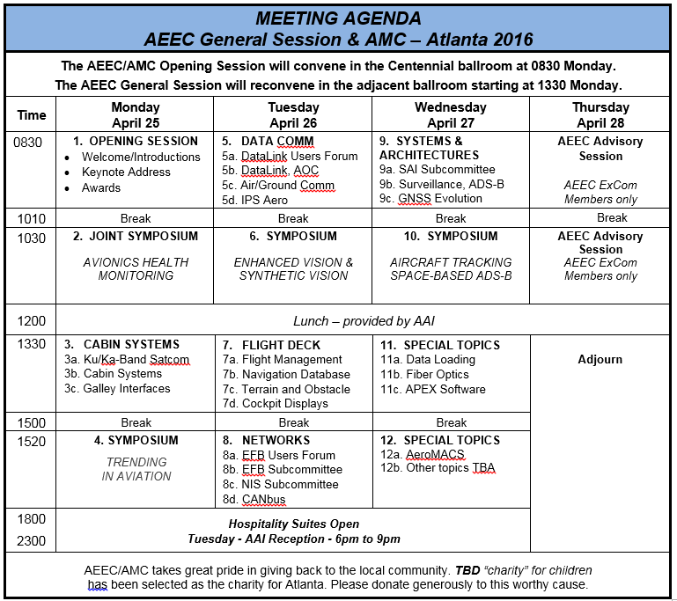
AEEC | AMC Agenda Overview

