Slide 1
Proposal for
Aircraft reporting of
VDL channel utlization
Zbig Jasiukajc
June 12, 2020

Slide 2
Background
Channel Utilization is a critical parameter for tracking network performance
CU value used in T1 calculation
Ground stations only measure CU in their own local RF environment
Aircraft have a full view of the RF channel
AEEC-750 VDR provides CU value to the CMU
CMU can track the CU from VDR and report it to the ground network

Slide 3
VDL network
Aircraft measures the
CU in the entire service volume
. . .
Each VGS measures
CU only in its own
local RF environment

Slide 4
Proposal for calculation of CU stats by CMU
CU tracking by CMU:
  Only performed while the aircraft is in the air
  Continually calculate the average of CU values reported by the VDR in 1 minute intevals
  Continually keep track of the number of TM2 (channel congested) events
  Clear the CU stats when switching frequencies
  Clear the TM2 events tracker stat immediately after link establishment/handoff
  Report the stats as a private parameter in every downlink XID frame such as XID_CMD_LE, XID_CMD_HO, XID_RSP_HO, XID_CMD_LCR etc.

Slide 5
Channel Utilization parameter
New private parameter for downlink XIDs:
  parameter ID = 0x8C
  parameter length = 1
  parameter value bits 1-7 = average CU, in a range from 0 to 100% with 1%
  resolution during the most recent 1 minute interval
  parameter value bit 8 = 1 if at least one TM2 event occured during the previous linK
  0 if no TM2 events occured during previous link

Slide 6
Supporting information
One day of VDL traffic was analyzed to evaluate and compare CU reporting in XID frames vs RR frames
Date selected = March 8, 2020 (before COVID-19 traffic drop)
Overall results:
Channel | # of downlink XIDs | XIDs with A/G = air | XIDs with A/G = air and valid LAT/LON |  | # of downlink RR frames
CSC | 40014 | 34512 | 24008 |  | 219778
ENR | 48209 | 47581 | 33714 |  | 330947
TERM | 13895 | 6149 | 5062 |  | 51257

Slide 7
Supporting information
Time distribution (over one day) and geographical location of XIDs evaluated to determine if sufficient amount of information could be obtained
Service volume over Amsterdam was selected for analysis
Number of usable XIDs in 5 minute intervals calculated

Slide 8
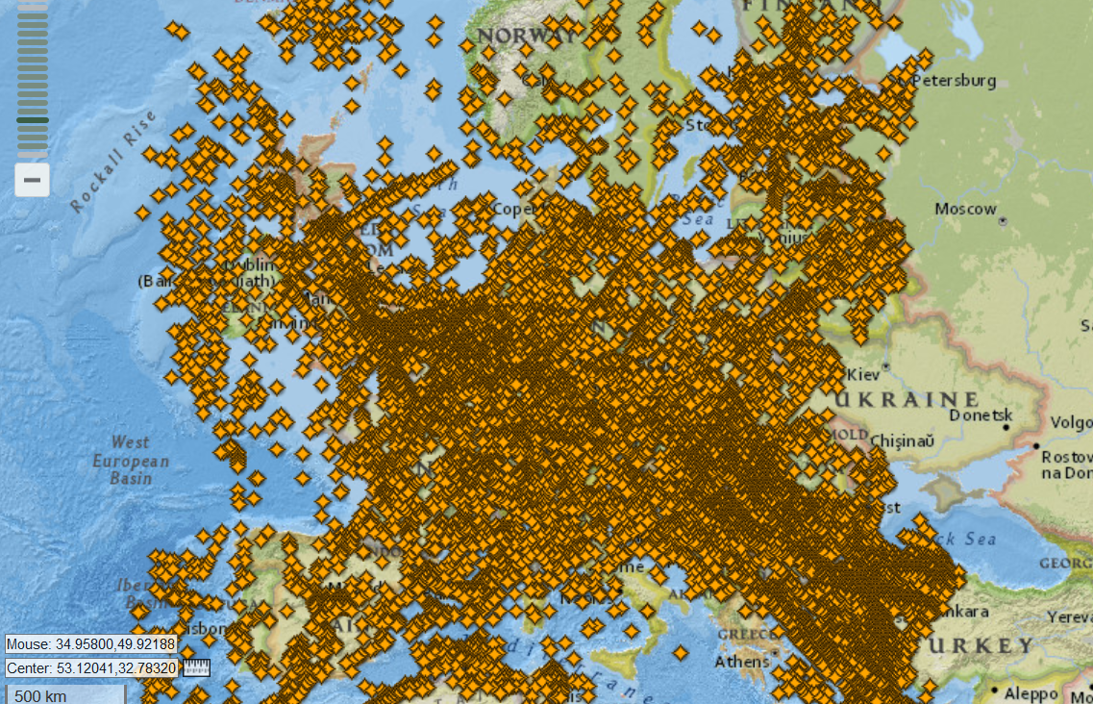
Supporting information
Heat map of downlinks XIDs on CSC channel on March 8, 2020

Slide 9
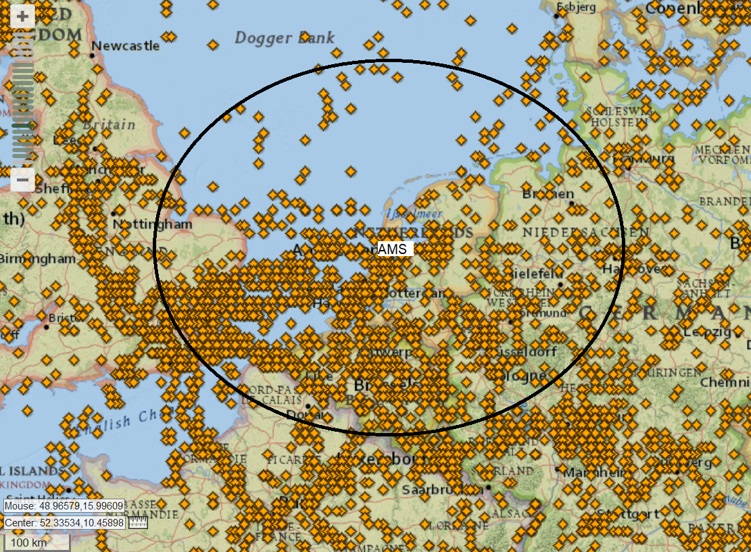
Supporting information
Amsterdam CSC service volume (180 nm radius)

Slide 10
Supporting information
Usable downlink XIDs received in AMS service volume on March 8.

Slide 11
Supporting information
AMS service volume analysis results:
- up to 25 XIDs received in any 5 minute period on March 8
- lowest number of received XIDs (during busy period) is 3
Conclusion:
- using XIDs provides sufficient amount of information to have a good
view of the CU observed by aircraft within a shared service volume
- reporting CU by adding a 3-byte parameter in XIDs adds much less
overhead than appending a CU byte to every downlink RR

Slide 12
Thank you
Zbig Jasiukajc
Manager, Avionics Qualification and System Integration
SITAONAIR
71, av. Louis Casaï, PO Box 42
1216 Cointrin, Geneva, Switzerland
Simply connect to www.sitaonair.aero

