Slide 1
Improving RESILIENCE OF VDLM2 COMMUNICATIONS IN THE PRESENCE OF
BROADBAND VHF interference
APRIL 8, 2020

Slide 2
BACKGROUND: vdlM2 INTERFERENCE events - introduction
Over that last several years, Collins IMS has seen an increasing number of reports of VDLM2 nocomms while the aircraft are located in the terminal/gate area.
  Causes undelivered preflight data such as Initializations, Weight-and-Balance and FAA Departure Clearances (DCLs).
  Crew are unable to transmit preflight AOC & ATC downlinks
Aircraft remain on VDL; do not fall back to POA
  Communications on VDL typically resume after the aircraft push back from the gate area.
  Ground stations and coverage are healthy / working properly
Aircraft operating on classic ACARS (POA) are not unaffected.

Slide 3
VDLM2 Interference events: Diagnosing the situation
1st step: Reviewing ACARS audits:
  ACARS audits simply show unacknowledged uplink attempts - no interference profile
2nd Step: A review of VDL-layer AVLC Logs:
  Multiple AVLC uplinks attempts typically show no aircraft response – aircraft problem?
3rd /4th Step: Station diagnostics & stats typically show a “healthy” station – field technicians inspect station and confirm proper operation.
5th / Final: Engineering along w/ Airline & local airport support and Spectrum Analyzers visit gate locations and search for a raised noise floor and, by process of elimination the source of interference.
  Airport authorities are sometime not cooperative with the powering down of probable interference sources.

Slide 4
VDLM2 Interference events: improved diagnostics and considerations:
Repeated events have improved our ability to diagnose an interference event by looking at AVLC logs:
  AVLC Logs show the aircraft send a batch of queued RRs once the aircraft moves back from the source
  The aircraft are hearing our uplink attempts but will not attempt downlinks because the VDR senses RF noise - the channel is busy.
Expensive and Time Consuming Proposition: Scheduling engineering resources for comprehensive, on-site, spectrum analysis impacts our response time.

Slide 5
Recent interference events for illustration

Slide 6
Examples of recent interference events:
CHICAGO ORD Gate #C9: VDL Intermittent Nocomms:
  Airport inspections and RGS visit showed everything working properly
  Engineering tests w/ spectrum analyzers identified a raised noise floor at the gate and was isolated to LED Strip lighting at a kiosk within the gate area.
NASHVILLE BNA (and similar at St. Louis STL):
  After several visits an interference source was isolated to LED spot lights that were installed on the jetway of one airport gates. Replacement with incandescent lights resolved the problem.
  Standard consumer FEIT LED Floodlight: FEIT Electric PAR38(FCC UL Listed 4KZ0)
LAX Terminal #6: VDLM2 Nocomm at numerous gates. A remodeled terminal involved the use of 100s of LEDs raising the noise floor to -80 dBm. Still under review with the airport authorities.
LAX Terminal #1: A VDL Nocomm at several gates was isolated to a data converter device mounted onto the jetway. Review of usage at other sites is under way.

Slide 7
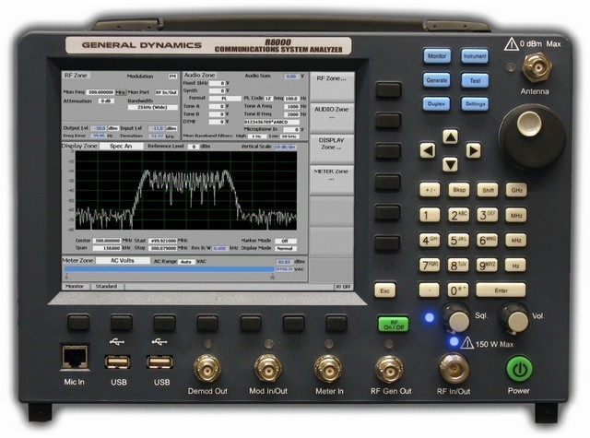
Engineering Review of BNA
Careful assessment of the RF Environment at BNA
Test Equipment:
  R8000B Communications System Analyzer (Setting: 25kHz BW, ~100Hz RBW)
  RC/IMS Developed Tools to Measure Background Noise Relative to RSSI
  Handheld Retractable Antenna
  Interference Source Isolated to
  LEDs: External Jetway Lighting

Slide 8
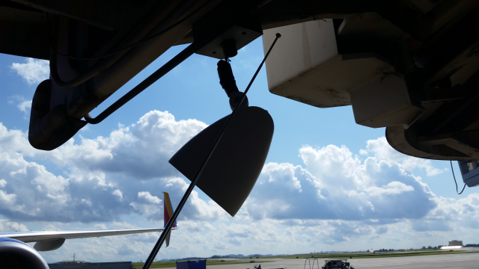
Test Antenna at Jetway & LED Lights

Slide 9
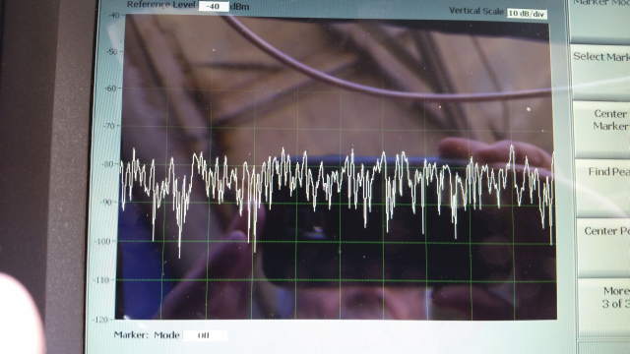
Analyzer Display:
LEDs On - Wideband Noise
Nose floor at -80 dBm. VDL Levels of -60 dBm (S/N) would be required to decode an VDLM2 transmission

Slide 10
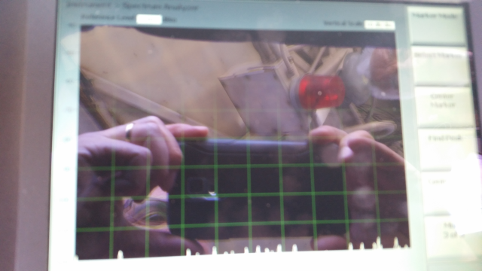
Analyzer Display:
LEDs OFF: Background Noise is Reduced by 40dB

Slide 11
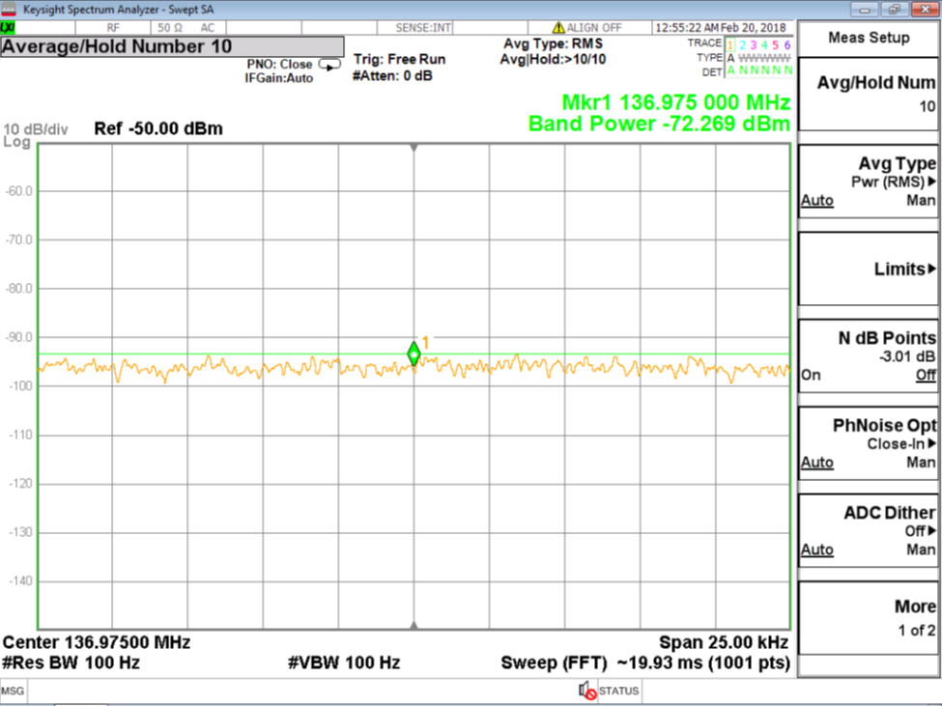
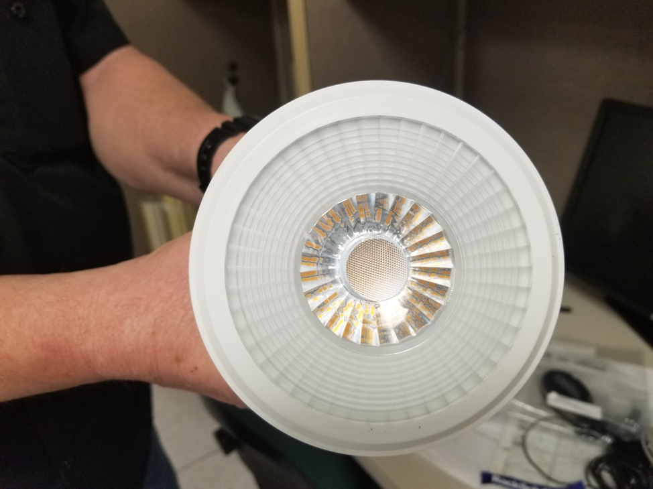
LAB Testing of feit LED spotlight
Using Keysight MXA Signal Analyzer
Wideband noise from 127 MHz to 137 MHz.
Spec A Settings: 136.975 MHz, Span is 25 kHz, Res BW 100 Hz
Noise: -59 dBm Surface, -65 dBm @ 2 ft; -72 dBm @ 4 ft
FEIT Electric PAR38 LED Spotlight

Slide 12
Assessment :
A GLOBAlink/VHF Experience…
The proliferation of LED lighting is continuing as airport authorities look for ways to conserve energy and reduce cost
  LED light does not cause interference; the embedded AC to DC power supply does…
  30 to 300 MHz band particularly susceptible
The effectiveness of previous outreach programs (AEEC) to warn the aviation industry of the potential troubles with low cost LEDs is unknown.
We can expect the continued introduction of new classes of products such as Ethernet converters and WiFi devices to be introduced into the airport environment.
While VDL may not be the root cause, we must consider options that could make VDLM2 less susceptible to these interference sources.

Slide 13
TWO interference impacts:
We can take actions to help with one:
Interference on the VDL Channel can cause two impacts:
A) Interfering signals on the VDL channel make it impossible to decode the uplinks and or downlink VDL transmissions, or,…
B) Interfering signals on the VDL channel are not strong enough to prevent the decoding of uplinks and downlinks; but, the aircraft will not attempt to transmit because it considers the channel busy.
Most of our recent events fall into category B. The aircraft could successfully communicate but it will not because the channel is busy.
In the rest of this presentation, we consider an approach to solve category B – the VDR considers the channel is busy

Slide 14
A review of industry standards for channel busy detection

Slide 15
RTCA Standards for CBD
RTCA DO-224D – “Signal-In-Space Minimum Aviation System Performance Standards (MASPS) For Advanced VHF Digital Data”
Requirements:
  Idle to Busy -98dBm
  Busy to Idle -100 dBm
  Many aircraft VDRs appear to be using this standard.
RTCA DO 281C – “Minimum Operational Performance Standards (MOPS) for Aircraft VDL Mode 2 Physical Link and Network Layer”
Requirements:
  Refers back to DO-224D.
  Tests are based on Idle to Busy -98dBm and Busy to Idle -100 dBm

Slide 16
ICAO standards for CBD:
ICAO Doc 9776 Manual on VHF Digital Link (VDL) Mode 2, 2nd Ed.
Requirements:
  None
  Implementation Aspects suggests that the receiver may use a noise floor estimator that dynamically adjusts the busy/idle levels.
International Standards and Recommended Practices (SARPS) Aeronautical Telecommunications, Annex 10 To the Convention on International Civil Aviation, Volume III, (Part I Digital Data Communication Systems; Part II Voice Communication Systems)”, Incorporating Amendments up to 88A
Requirements:
  Idle to Busy -90dBm
  Busy to Idle -92 dBm
Note: Collins IMS RGS Transceivers employ this standard.

Slide 17
AEEC (ARINC) standards for CBD & summary:
ARINC Characteristic 750-4, VHF radio.
  Requirements: Refers back to the SARPS (-90/-92 dBm)
  Perhaps there was an update to this reference?
ARINC Specification draft 631-8, VHF Digital Link (VDL) Mode 2 Implementation Provisions.
  Requirements: Refers back to the SARPS
Industry Standard | CBD Idle/Busy dBm
RTCA DO-224D | -100/-98
RTCA DO 281C | (See DO-224D)
ICAO Doc 9776 | None, Example Estimator
ICAO SARPS | -92/-90
AEEC 750-4 | (See SARPS)
AEEC Draft 631-8 | (See SARPS)

Slide 18
An assessment of industry standards regarding channel busy detection:
The AEEC and RTCA standards were developed to prevent collisions on the VDLM2 channel:
  Carrier Sense Multiple Access (CSMA) based on RF energy detection vs. D8PSK modulation
  The VDLM2 channel shall be considered busy if the RF level exceeds -100 dBm (a very weak signal)
  Avionics VDRs tested appear to be set for this RTCA value of -100 dBm
  VDLM2 modems require 20 dB S/N to decode. RGS must provide a level of -80 dBm at the gate
ICAO suggested a more interference tolerant “channel busy” (CBD) value of -90 dBm.
With the proliferation of LEDs and other interference sources we are seeing a rapidly growing number of failed uplinks within the gate areas due to interference events.
  LEDs are not going away
  Successful VDL communications could be supported if the avionics VDR were less “polite” and attempted to transmit.

Slide 19
Recommendations:

Slide 20
Recommendations for a revised VDL CBD:
Option #1: Most direct: VDR Parameter/Level Change:
  Revise the Avionics VDRs to follow the SARPS recommended Idle/Busy levels of -92/-90 dBm.
  This will match Collins IMS RGS implementation
Option #2: Refer to ICAO Doc 9776 and develop a noise floor estimator which will dynamically adjust the idle/busy channel thresholds based on ambient noise. More complex SW change; proprietary .
Option #3: Revise the RTCA standards and then the VDRs. Apply CBD based on D8PSK modulation vs. energy sense.
  How much signal to noise ratio does the receiver require to detect modulation? 10-15dB of SNR.
  With this approach, any transmission may be stepped on if the received level is local noise floor plus 10-15dB. Effect is to decrease channel throughput.
Option #4: Continue with the RTCA DO-224D recommended Idle/Busy levels of -100/-98 dBm. Change the FCC emission standards for non-intentional radiating devices and go “attack” every new device used within the airport environment today and tomorrow.

Slide 21
Conclusion / summary:
LEDs and other sources of interference in the VDL band are being deployed at an accelerated rate.
We are seeing many more undelivered uplinks with a root cause of interference.
The original VDR standards for CBD were prepared to reduce collisions and could not predict the environment we have 20 years later.
  How much does it cost to replace a light bulb?
We strongly encourage the industry to consider adopting a revised CBD Algorithm based on the ICAO SARPS levels of -90/-92 dBm or some sophisticated concept that considers the gate environment of today.
Questions?

