Slide 1
ICAO – RTCA
Busy – Idle detection levels

Slide 2
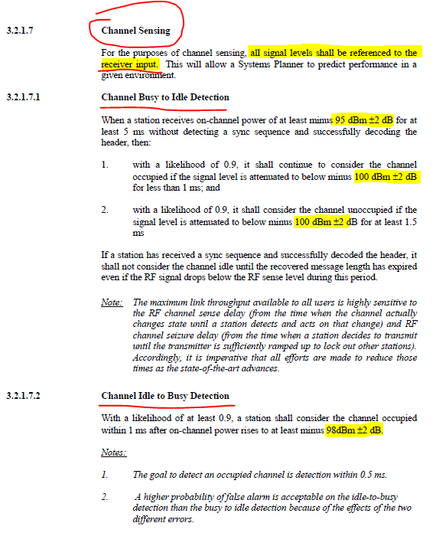
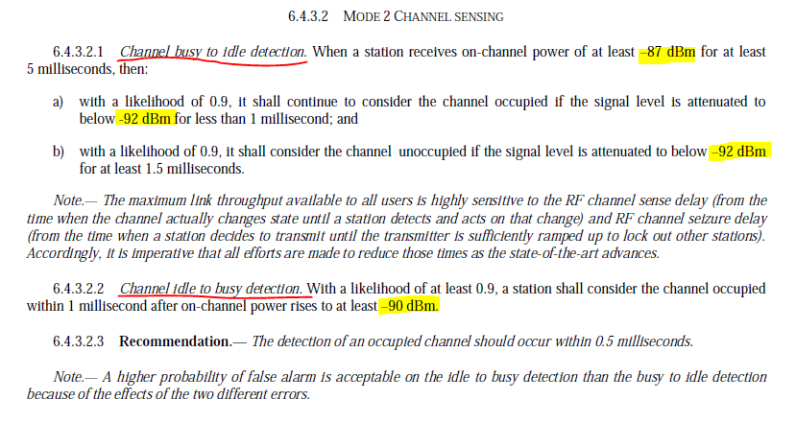

ICAO Doc 9776
RTCA DO-224C
Values are assumed to be at the antenna

Slide 3
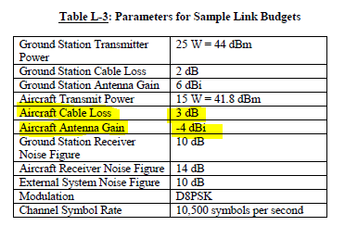
RTCA DO-224C
ICAO <-> RTCA
-87 dBm <-> 95 dBm +-2dB
-90 dBm <-> 98 dBm +-2dB
Δ=8dB +- 2dB
7 dB
A/C cable + antenna losses

