Slide 1
ARINC 810
DEFINITION CENTER OF GRAVITY AND MAX. CROSS WEIGHT
REVISION B – CW23 , 2024

Slide 2
SUMMARY
GAIN SIZE DEFINITION ACC. ARINC 810
OVERVIEW SAFRAN CABIN GERMANY GAINS ARINC 810 SIZE 1 - „MAX CROSS WEIGHT” AND „CENTER OF GRAVITY”
EXAMPLE WATER HEATER P/N 9412-01-0000-01
OVERVIEW ALL SAFRAN CABIN WET PRODUCTS
OVERVIEW SAFRAN CABIN GERMANY GAINS ARINC 810 SIZE 2 - „MAX CROSS WEIGHT” AND „CENTER OF GRAVITY”
EXAMPLE P/N 8318-01-0000-01
OVERVIEW ALL SAFRAN CABIN OVENS / BEVERAGE CHILLER
OVERVIEW SAFRAN CABIN GERMANY GAINS ARINC 810 SIZE 3 - „MAX CROSS WEIGHT” AND „CENTER OF GRAVITY”
EXAMPLE P/N T900200
OVERVIEW ALL SAFRAN CABIN GAINS TRASH COMPECTOR
OVERVIEW SAFRAN CABIN GERMANY GAINS ARINC 810 SIZE 4 - „MAX CROSS WEIGHT” AND „CENTER OF GRAVITY”
EXAMPLE P/N 8933-01-0000-01
OVERVIEW ALL SAFRAN CABIN BUN WARMER
ARINC INFORMATION

Slide 3
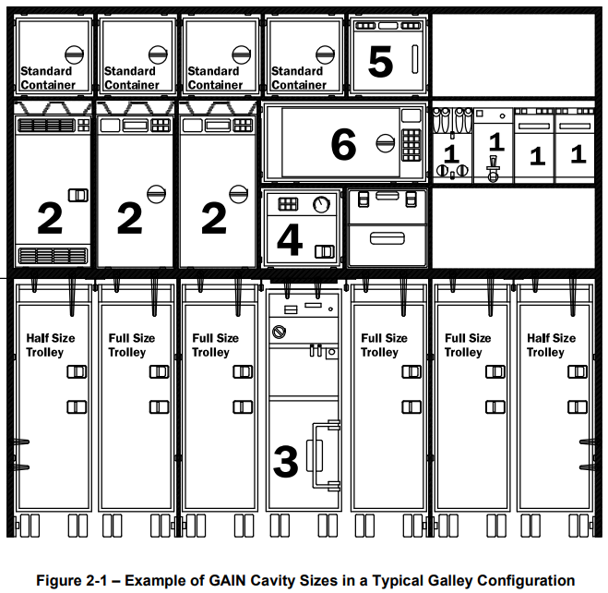
GAIN SIZE DEFINITION ACC. ARINC 810

Slide 4
OVERVIEW SAFRAN CABIN GERMANY WET PRODUCTS „MAX CROSS WEIGHT” AND „CENTER OF GRAVITY”
SIZE 1

Slide 5
OVERVIEW SAFRAN CABIN GERMANY WET PRODUCTS „MAX CROSS WEIGHT” AND „CENTER OF GRAVITY”
SIZE 1
* INFO DIMENSION Z-DIRECTION: GAIN „CENTER OF GRAVITY“ GROSS WEIGHT DIMENSION + 1,6MM[0,06“] RUBSTRIP TO GALLEY COMPARTMENT = Z-DIRECTION (SEE OVERVIEW GAIN INTO GALLEY COMPARTMENT SHEET BEFOR)

Slide 6
SIZE 2
OVERVIEW SAFRAN CABIN GERMANY OVENS „MAX CROSS WEIGHT” AND „CENTER OF GRAVITY”

Slide 7
OVERVIEW SAFRAN CABIN GERMANY OVENS „MAX CROSS WEIGHT” AND „CENTER OF GRAVITY”
SIZE 2
OVERVIEW OVENS ACC. ARINC 810 SIZE 2 DEFINITION CENTER OF GRAFITIY
 | ARINC 810 INTERFACE - STANDARD VERSION
 | CROSS WEIGHT (SEE ICD DRAWING) |  | *Z-DIRECTION |  | *Y-DIRECTION
SAFRAN P/N | KG | LBS | MM +/- 25MM | INCH +/- 1" | MM +/- 25MM | INCH +/- 1"
8305-01-0000-01 ARINC 810 SUPPLEMENT 3 | 39,4 | 86,88 | 246 | 9,69 | 230,4 | 9,07 | CONVECTION
8306-01-0000-01 ARINC 810 SUPPLEMENT 3 | 40,4 | 89,07 | 246 | 9,69 | 230,4 | 9,07 | STEAM
8315-01-0000-01 ARINC 810 SUPPLEMENT 5 | 40,4 | 89,07 | 256 | 10,08 | 244,7 | 9,63 | CONVECTION
8316-01-0000-01 ARINC 810 SUPPLEMENT 5 | 40,4 | 89,07 | 256 | 10,08 | 244,7 | 9,63 | STEAM | without tolerance MAX.
 |  |  | no tolerance indicated on ICD
X300 ARINC 810 INTERFACE | 40,1 | 88,3 | 254,4 | 10,02 | 248,9 | 9,8 | STEAM
W300 ARINC 810 SUPPLEMENT 5 | 42,3 | 93,3 | 258 | 10,16 | 269 | 10,59 | BEVERAGE CHILLER | MAX.
 | ARINC 810 INTERFACE - EXTEMDED VERSION
 | CROSS WEIGHT (SEE ICD DRAWING) |  | Z-DIRECTION |  | Y-DIRECTION
SAFRAN P/N | KG | LBS | MM +/- 25MM | INCH +/- 1" | MM +/- 25MM | INCH +/- 1"
8307-01-0000-01 ARINC 810 INTERFACE | 40,5 | 89,3 | 250 | 9,84 | 268,4 | 10,57 | CONVECTION
8308-01-0000-01 ARINC 810 INTERFACE | 41,5 | 91,5 | 250 | 9,84 | 268,4 | 10,57 | STEAM
8317-01-0000-01 ARINC 810 INTERFACE | 41,5 | 91,5 | 252 | 9,96 | 296,4 | 11,7 | CONVECTION
8318-01-0000-01 ARINC 810 INTERFACE | 41,5 | 91,5 | 252 | 9,96 | 296,4 | 11,7 | STEAM | MAX.
 | 4 | mm RUBSTRIP CAP TO GALLEY COMPARTMENT ADDED
 | 25,4 | mm DIMENSION GALLEY ATTACHEMENT
* INFO DIMENSION Z-DIRECTION: GAIN „CENTER OF GRAVITY“ GROSS WEIGHT DIMENSION + 4MM[0,15“] RUBSTRIP TO GALLEY COMPARTMENT = Z-DIRECTION * INFO DIMENSION Y-DIRECTION: GAIN „CENTER OF GRAVITY“ GROSS WEIGHT DIMENSION + 25,4MM[1“] ATTACHEMENT POINT DIMENSION = Y-DIRECTION (SEE OVERVIEW GAIN INTO GALLEY COMPARTMENT SHEET BEFOR)

Slide 8
SIZE 3
OVERVIEW SAFRAN CABIN GERMANY TRASH COMPECTOR „MAX CROSS WEIGHT” AND „CENTER OF GRAVITY”

Slide 9
OVERVIEW SAFRAN CABIN GERMANY TRASH COMPECTOR „MAX CROSS WEIGHT” AND „CENTER OF GRAVITY”
SIZE 3

Slide 10
SIZE 4
OVERVIEW SAFRAN CABIN GERMANY BUN WARMER „MAX CROSS WEIGHT” AND „CENTER OF GRAVITY”

Slide 11
OVERVIEW SAFRAN CABIN GERMANY BUN WARMER „MAX CROSS WEIGHT” AND „CENTER OF GRAVITY”
SIZE 4
* INFO DIMENSION Z-DIRECTION: GAIN „CENTER OF GRAVITY“ GROSS WEIGHT DIMENSION + 4MM[0,15“] RUBSTRIP TO GALLEY COMPARTMENT = Z-DIRECTION * INFO DIMENSION Y-DIRECTION: GAIN „CENTER OF GRAVITY“ GROSS WEIGHT DIMENSION + 25,4MM[1“] ATTACHEMENT POINT DIMENSION = Y-DIRECTION (SEE OVERVIEW GAIN INTO GALLEY COMPARTMENT SHEET BEFOR)

Slide 12
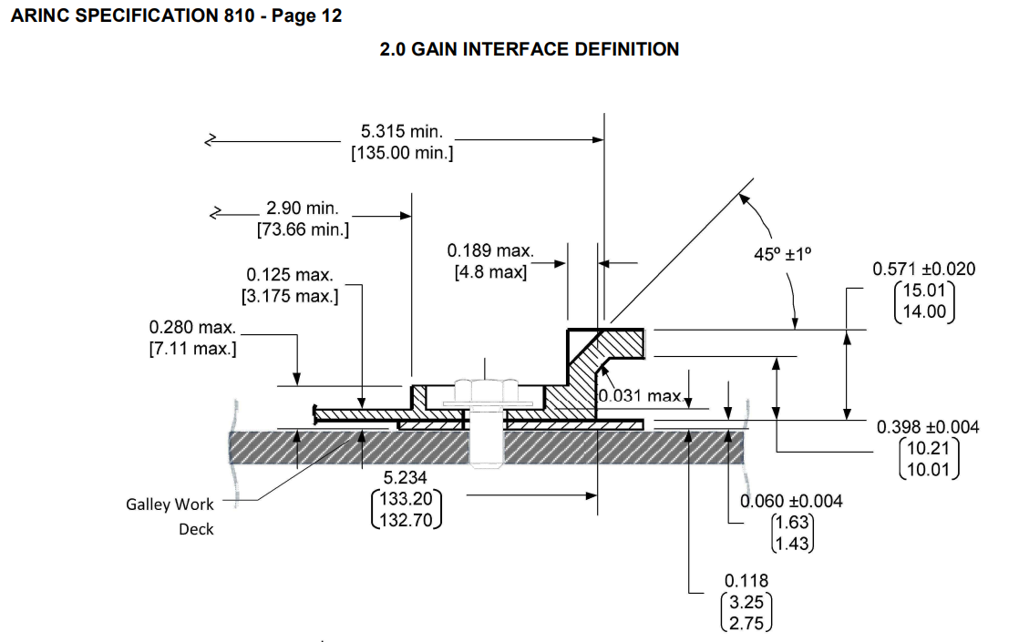
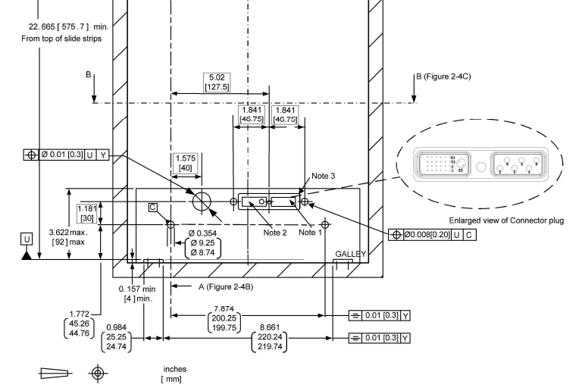
ARINC SPECIFICATION INFO
ARINC SIZE 1
ARINC SIZE 2
1,6mm RAIL CAP BETWEEN GAIN AN COMPARMTENT
4mm RUBSTRIP CAP BETWEEN GAIN AN COMPARMTENT

