Slide 1
Presentation to AEEC on the DIFI ISTO-4900 standard
Jim Rosenberg, CTO Wavestream, Board of Directors DIFI Consortium

Slide 2
Disclaimer
I consulted the Chair of the DIFI Consortium prior to making this presentation and received his encouragement to present to AEEC
… that said …
While I have done my best to represent the DIFI positions as accurately as I understand them, this presentation has not been vetted by the Board, and the content should not be regarded as a formal position of the Consortium
Notes:
The title of this presentation in the agenda is “link establishment”. As I shall try to clarify by example, ISTO-4900, as presently defined, probably cannot be described as a complete link establishment protocol – more of this may be included in the future

Slide 3

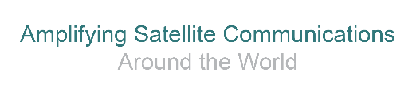
How can we help each other?
AEEC would like information to guide the determination of required fiber count and channel capacity to support digital communication between modem and RF equipment
DIFI is interested in information on the airborne standards roadmap that can help guide the refinement of the DIFI standard(s)
What can I do, here today?
  Provide some background on the scope of the current standard
  Review methods for digitizing SATCOM signals; clarify their relationship to the DIFI standard and “waveform agnosticism”
  Discuss the content and meaning of the DIFI Context and Data Packets
  Discuss methods of synchronization between modem and RF equipment
  Discuss some potential operational scenarios and data capacities consistent with the current standard
  Take a glimpse at potential future refinement?
  DIFI organization: the Board, the Specification Working Group, and the Certification Working Group
  Listen to AEEC questions and concerns
Notes:
It is possible that some of you may find the scope of the present standard disappointing, but after sitting in on yesterday’s session, I’m relieved to understand that we may not be the only organization who haven’t yet incorporated into the standard all the features that every member of the organization would like to have.

Slide 4
Architectures: Data, Synchronization, and Control Planes
Different use cases offer different facilities and have radically different requirements
Consider just three:
  military gateway
  cloud-virtualized teleport
  airborne terminal
The military gateway application is characterized by:
  All equipment on a compact campus with relatively short, dedicated (low latency) connections
  There are a very large number of modems connected to RF equipment through switch
  The localized system enables and the large number of modems operating at multiple sample rates and requires the use of a synchronization plane and a control plane

Slide 5
Architectures: Data, Synchronization, and Control Planes
The Cloud-virtualized Teleport application is characterized by
  equipment is remotely located, potentially separated by very large distances
  non-dedicated connections with high and variable latency
  no dedicated synchronization plane available, typically no separate control plane used

Slide 6
Architectures: Data, Synchronization, and Control Planes
The Airborne Terminal application is characterized by
  all equipment essentially co-located (within ~10 meters) with relatively short, dedicated (low latency) connections
  inbound traffic (Rx) is generally larger than outbound (Tx)
  synchronization and control planes could be made available
It is clear that creating a single standard that addresses such a wide range of use cases is a large task
The DIFI Consortium started by composing a standard that addresses the formatting of signal data on the data plane
Notes:
Note that if one has multiple modems, they can operate on a common fiber Ethernet link, separated in messaging by individual IP addresses. Even better would be the use of virtualized modems on common hardware, with a single, dedicated fiber link.

Slide 7
Analog, Digitized Waveform and Symbol Stream Signaling
Modern modems use digital modulators the output of which is then converted to an analog L-band signal
The conversion to/from the analog domain can be shifted to the edge device (BUC/LNB); signaling is simply a digitized baseband version of the L-band signal
It is possible on the Tx side to move the modulator to the BUC, which substantially reduces the data rate on the digital link

Slide 8
Analog, Digitized Waveform and Symbol Stream Signaling
Modern modems use digital modulators the output of which is then converted to an analog L-band signal
The conversion to/from the analog domain can be shifted to the edge device (BUC/LNB); signaling is simply a digitized baseband version of the L-band signal
Symbol Stream is most useful when the Tx data rate is very high and significantly higher than the Rx data rate
  Airborne applications have neither of these conditions
  Digitized waveform is completely waveform agnostic
  Digitized waveform is likely to be preferable for airborne terminals

Slide 9
Scope of the Present ISTO-4900 Standard
The present DIFI standard is a data plane standard, and does not include any specification regarding a control plane or synchronization plane
The present standard is a digitized waveform standard, and focuses on how to format digitized waveform data and certain related transmission parameters (e.g., RF center frequency, sample rate, bit depth of the samples, etc.) in data/signal plane packets
The format of the packets follows VITA 49.2 convention (although the VITA 49 standard is very broad, and includes many features not used by the DIFI standard)
While synchronization is not covered by the present version of the standard, several implementations have been demonstrated, including demo’s using no separate synchronization plane (i.e., using only the data stream for synchronization)
DIFI has stated goals for the coming year to “address deficiencies in the specification” and to “publish additional standards” – inputs from AEEC regarding issues of importance would be timely, and can help guide the prioritization of this ongoing work

Slide 10
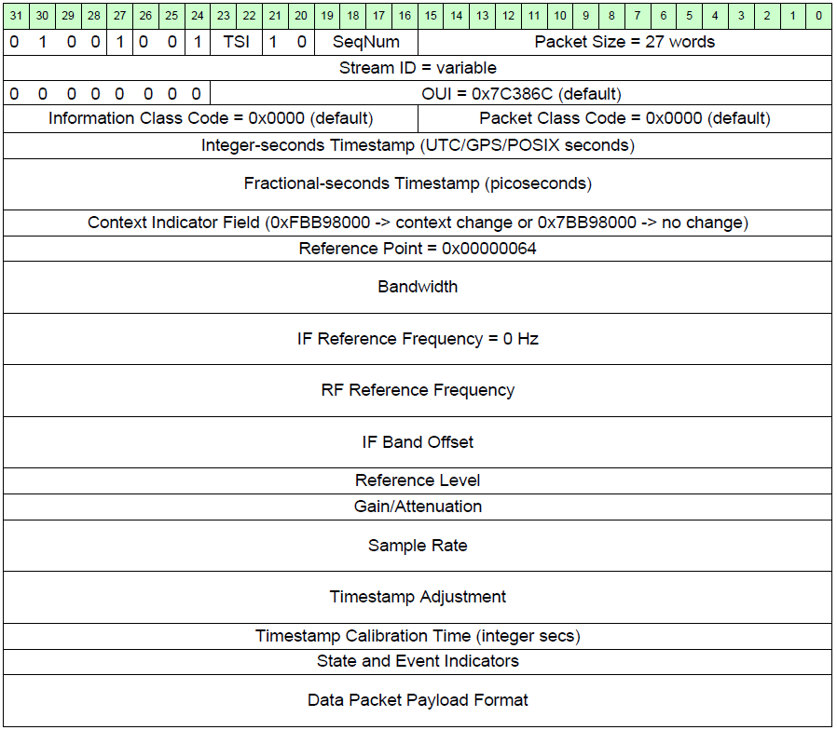
The ISTO-4900 Signal Context Packet
In the VITA 49 framework, the standard “Signal Context Packets” convey a variety of non-data parameters
Signal Context packets are issued periodically – the present ISTO-4900 standard calls for them to be issued at a rate of 10 per second
There are also “Version Context Packets” intended to convey which version of the standard being used (not discussed in this presentation)

Slide 11
The ISTO-4900 Signal Context Packet
This field indicates that this is a standard Signal Context Packet
In the VITA 49 framework, the standard “Signal Context Packets” convey a variety of non-data parameters
Signal Context packets are issued periodically – the present ISTO-4900 standard calls for them to be issued at a rate of 10 per second
There are also “Version Context Packets” intended to convey which version of the standard being used (not discussed in this presentation)

Slide 12
The ISTO-4900 Signal Context Packet
This bit indicates Information Class and Packet Class fields are included
In the VITA 49 framework, the standard “Signal Context Packets” convey a variety of non-data parameters
Signal Context packets are issued periodically – the present ISTO-4900 standard calls for them to be issued at a rate of 10 per second
There are also “Version Context Packets” intended to convey which version of the standard being used (not discussed in this presentation)

Slide 13
The ISTO-4900 Signal Context Packet
Housekeeping bits having to do with how the timestamps are created and used
In the VITA 49 framework, the standard “Signal Context Packets” convey a variety of non-data parameters
Signal Context packets are issued periodically – the present ISTO-4900 standard calls for them to be issued at a rate of 10 per second
There are also “Version Context Packets” intended to convey which version of the standard being used (not discussed in this presentation)

Slide 14
The ISTO-4900 Signal Context Packet
Packets are numbered modulo 16 to help reorder them at the receiver if they are received out of order,
The number of words in the Packet is also recorded in the first word of the Packet
In the VITA 49 framework, the standard “Signal Context Packets” convey a variety of non-data parameters
Signal Context packets are issued periodically – the present ISTO-4900 standard calls for them to be issued at a rate of 10 per second
There are also “Version Context Packets” intended to convey which version of the standard being used (not discussed in this presentation)

Slide 15
The ISTO-4900 Signal Context Packet
VITA 49 supports having the source of the digital data emitting multiple streams of data on a single data plane … the multiple streams are assigned distinct numbers
In the VITA 49 framework, the standard “Signal Context Packets” convey a variety of non-data parameters
Signal Context packets are issued periodically – the present ISTO-4900 standard calls for them to be issued at a rate of 10 per second
There are also “Version Context Packets” intended to convey which version of the standard being used (not discussed in this presentation)

Slide 16
The ISTO-4900 Signal Context Packet
In the VITA 49 framework, the standard “Signal Context Packets” convey a variety of non-data parameters
Signal Context packets are issued periodically – the present ISTO-4900 standard calls for them to be issued at a rate of 10 per second
There are also “Version Context Packets” intended to convey which version of the standard being used (not discussed in this presentation)
This field indicates the number of bits in the Signal Data Packet that are pad bits to fill out the last word in the Packet – in the present ISTO-4900 standard, padding is not permitted (data must fill an integral number of 32-bit words), so this field is all zeros

Slide 17
The ISTO-4900 Signal Context Packet
In the VITA 49 framework, the standard “Signal Context Packets” convey a variety of non-data parameters
Signal Context packets are issued periodically – the present ISTO-4900 standard calls for them to be issued at a rate of 10 per second
There are also “Version Context Packets” intended to convey which version of the standard being used (not discussed in this presentation)
This field contains an “Organizationally Unique Identifier” assigned by the IEEE; The Information Class belongs to the OUI, and the Packet Class belongs to the Information Class

Slide 18
The ISTO-4900 Signal Context Packet
In the VITA 49 framework, the standard “Signal Context Packets” convey a variety of non-data parameters
Signal Context packets are issued periodically – the present ISTO-4900 standard calls for them to be issued at a rate of 10 per second
There are also “Version Context Packets” intended to convey which version of the standard being used (not discussed in this presentation)
Information Classes and Packet Classes are a hierarchical system for specifying to the Signal Data Stream receiver how the Data Packets should be interpreted … for example, one could imagine having an Information Class for a link that is intended to operate with Data Plane synchronization only, and another for a link that is intended to operate with a Synchronization Plane – within the latter, there could be various Packet Classes for different frequency references
Presently there are no Information Classed or Packet Classes defined in ISTO-4900, but they are available because bit 27 of word #1 calls for their inclusion

Slide 19
The ISTO-4900 Signal Context Packet
In the VITA 49 framework, the standard “Signal Context Packets” convey a variety of non-data parameters
Signal Context packets are issued periodically – the present ISTO-4900 standard calls for them to be issued at a rate of 10 per second
There are also “Version Context Packets” intended to convey which version of the standard being used (not discussed in this presentation)
These fields carry a timestamp (integer and fractional seconds) inserted by the emitter of the digital stream

Slide 20
The ISTO-4900 Signal Context Packet
In the VITA 49 framework, the standard “Signal Context Packets” convey a variety of non-data parameters
Signal Context packets are issued periodically – the present ISTO-4900 standard calls for them to be issued at a rate of 10 per second
There are also “Version Context Packets” intended to convey which version of the standard being used (not discussed in this presentation)
The value in this field calls out which of the very large number of parameters available within VITA 49 will be used in this packet.
There are two values used, one when the Context Packet values have changed since the last Packet and another when they are unchanged

Slide 21
The ISTO-4900 Signal Context Packet
In the VITA 49 framework, the standard “Signal Context Packets” convey a variety of non-data parameters
Signal Context packets are issued periodically – the present ISTO-4900 standard calls for them to be issued at a rate of 10 per second
There are also “Version Context Packets” intended to convey which version of the standard being used (not discussed in this presentation)
This field defines the points in the system to which the measurements are referenced. The particular value shown indicates that the reference planes are the RF planes (both input and output).

Slide 22
The ISTO-4900 Signal Context Packet
In the VITA 49 framework, the standard “Signal Context Packets” convey a variety of non-data parameters
Signal Context packets are issued periodically – the present ISTO-4900 standard calls for them to be issued at a rate of 10 per second
There are also “Version Context Packets” intended to convey which version of the standard being used (not discussed in this presentation)
This field defines the bandwidth of the signal represented by the digital stream

Slide 23
The ISTO-4900 Signal Context Packet
In the VITA 49 framework, the standard “Signal Context Packets” convey a variety of non-data parameters
Signal Context packets are issued periodically – the present ISTO-4900 standard calls for them to be issued at a rate of 10 per second
There are also “Version Context Packets” intended to convey which version of the standard being used (not discussed in this presentation)
The IF Reference Frequency is the center frequency of the digitized IF bandwidth – 0Hz indicates a baseband signal

Slide 24
The ISTO-4900 Signal Context Packet
In the VITA 49 framework, the standard “Signal Context Packets” convey a variety of non-data parameters
Signal Context packets are issued periodically – the present ISTO-4900 standard calls for them to be issued at a rate of 10 per second
There are also “Version Context Packets” intended to convey which version of the standard being used (not discussed in this presentation)
The RF Reference Frequency is the center frequency of the analog RF bandwidth

Slide 25
The ISTO-4900 Signal Context Packet
In the VITA 49 framework, the standard “Signal Context Packets” convey a variety of non-data parameters
Signal Context packets are issued periodically – the present ISTO-4900 standard calls for them to be issued at a rate of 10 per second
There are also “Version Context Packets” intended to convey which version of the standard being used (not discussed in this presentation)
The IF Band Offset is used when the signal bandwidth is not centered at the IF Reference Frequency (can be used to correct for Doppler shifts)

Slide 26
The ISTO-4900 Signal Context Packet
Reference Level and Gain/Attenuation fields are used to control the level of the output of the BUC or LNB. Reference Level is used to describe the analog behavior with zero Gain/Attenuation at full-scale digital signal, and Gain/Attenuation is used for controlling link gain.
In the VITA 49 framework, the standard “Signal Context Packets” convey a variety of non-data parameters
Signal Context packets are issued periodically – the present ISTO-4900 standard calls for them to be issued at a rate of 10 per second
There are also “Version Context Packets” intended to convey which version of the standard being used (not discussed in this presentation)

Slide 27
The ISTO-4900 Signal Context Packet
This field sets the sample rate for the D to A or A to D conversion
In the VITA 49 framework, the standard “Signal Context Packets” convey a variety of non-data parameters
Signal Context packets are issued periodically – the present ISTO-4900 standard calls for them to be issued at a rate of 10 per second
There are also “Version Context Packets” intended to convey which version of the standard being used (not discussed in this presentation)

Slide 28
The ISTO-4900 Signal Context Packet
This field indicates the time of the most recent update of the stream emitter’s clock
In the VITA 49 framework, the standard “Signal Context Packets” convey a variety of non-data parameters
Signal Context packets are issued periodically – the present ISTO-4900 standard calls for them to be issued at a rate of 10 per second
There are also “Version Context Packets” intended to convey which version of the standard being used (not discussed in this presentation)

Slide 29
The ISTO-4900 Signal Context Packet
In the ISTO-4900 standard, only two of the bits in this field are used, one indicating whether the local clock is synchronized to an external source, and whether the PLLs are locked to the reference.
In the VITA 49 framework, the standard “Signal Context Packets” convey a variety of non-data parameters
Signal Context packets are issued periodically – the present ISTO-4900 standard calls for them to be issued at a rate of 10 per second
There are also “Version Context Packets” intended to convey which version of the standard being used (not discussed in this presentation)

Slide 30
The ISTO-4900 Signal Context Packet
This field describes attributes of the Data Packet Payload Format, such as numerical format (e.g., fixed-point I and Q), and bit depth of the samples. Signed, fixed point I and Q at bit depths from 4 – 16 bits are permitted in the ISTO-4900 standard, with link-efficient packing and no zero padding.
In the VITA 49 framework, the standard “Signal Context Packets” convey a variety of non-data parameters
Signal Context packets are issued periodically – the present ISTO-4900 standard calls for them to be issued at a rate of 10 per second
There are also “Version Context Packets” intended to convey which version of the standard being used (not discussed in this presentation)
Notes:
As one can see, this is not a link establishment protocol, as presently defined – it is a packet-formatting protocol for the Data Plane, which also carries some ancillary information regarding frequency planning, gain, and sample rate

Slide 31
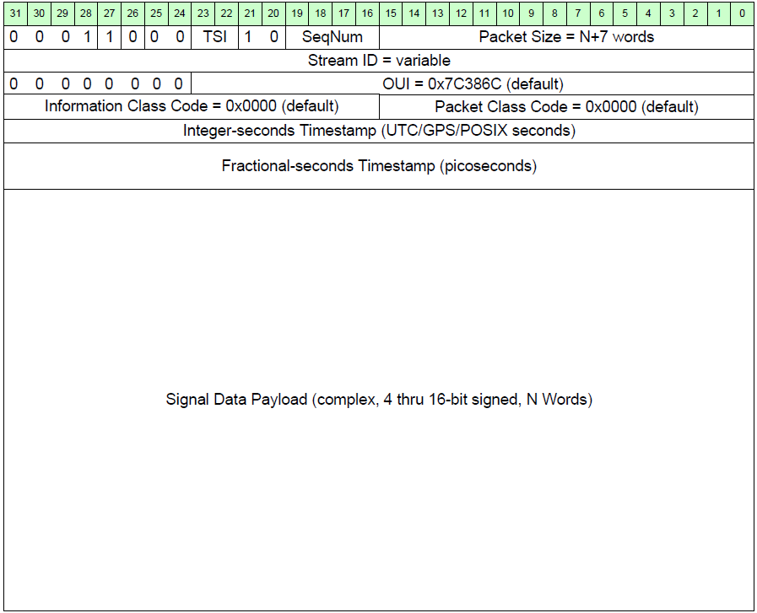
The ISTO-4900 Signal Data Packet
In the VITA 49 framework, the standard “Signal Data Packets” pick up a number of the header fields from the Signal Context Packets
Signal Data Packets are issued at whatever rate is necessary to carry the data stream
In systems demonstrated to date, these packets (Context and Data) have been sent using UDP encapsulation, but this is not a requirement of the ISTO-4900 Standard

Slide 32
A Step-by-Step Example
ISTO-4900 describes only the format of what the packetizer produces – the implementation of the downconverter is at the discretion of the DLNB manufacturer
Block diagram for single-conversion, zero IF, digital output LNB
For this example, the first bandpass filter selects the RF band accessed (e.g. 19.2-20.2GHz)
Following the I/Q downconversion to baseband (controlled by RF Ref. Frequency and IF Ref. Frequency), an anti-aliasing lowpass filter is applied, matched to the Nyquist rate of the ADC
A digital lowpass-decimation filter selects the channel to be received (controlled by Bandwidth), and downsamples to reduce the datarate to only that necessary
Other downconverter configurations are possible, such as double conversion, which can increase frequency plan flexibility, but add complexity

Slide 33
Fiber Capacity for the Data Stream
Consider an example for which:
the K-band bandpass filter is 1GHz wide
the inbound symbol rate can vary from 36Msym/sec to 500Msym/sec
12-bit depth is adequate for the A to D conversion
the sample rate (I and Q) will be 1.25 times the symbol rate
With these parameters
The sample rate will vary from 45Msample/sec to 625Msample/sec
The digitized data bit rate will be 24 times the sample rate (12 bits for I and 12 for Q), yielding rates from 1.08Gbit/sec to 15Gbit/sec
VITA 49 and UDP overhead is only a few percent
For presently used inbound symbol rates, 10GigE is more than sufficient, but anticipating symbol rates up to 500Msym/sec would require 2 lanes of 10GigE

Slide 34
Synchronization and Optional Synch’ and Control Planes
Today: in the legacy L-band systems one typically finds
  Coax cable carrying the L-band signal and a multiplexed reference signal (for synchronization)
  Control plane including
    Monitor and control connection, usually over twisted pair
    Assorted discrete signals specifically including a transmit disable/mute to manage mispointing and tail blockage
Future (1): it is possible to synchronize the BUC using only the stream of Signal Data Packets
  Character of the data stream
    Average arrival rate of packets is exactly 1/N of the sample generation rate, where N is samples/packet
    Even on a short, dedicated line, there is jitter in packet arrival that is significant compared with a sample period
    There must be a FIFO buffer in the BUC to “smooth out” the jitter
  Using the “fill level” of the buffer as an error variable driving a “PLL-like” control loop, the sample rate in the BUC can:
    be driven to have an average rate that exactly matches the sample rate in the modem
    have its jitter reduced by a factor proportional to the square root of the number of samples in the averaging (this drives the depth of the FIFO, but this is a practical solution in this use case)
    If the sample rate is locked to the Reference oscillator in the modem, the VCOCXO in the BUC can effectively be locked to the oscillator in the modem through this technique (which has been demonstrated experimentally)

Slide 35
Synchronization and Optional Synch’ and Control Planes
Future (2): In an airborne SATCOM system with a digital interface, one could imagine including
  A control plane for basic monitor and control functions, using either a pair of fibers or one bidirectional fiber for basic control, and a discrete fiber for the rapid muting necessary in airborne applications, possibly a discrete reset
  A synchronization plane including either or both of
    Reference signal, e.g., 10/50/100MHz clock
    Sample clock to synchronize BUC DAC and LNB ADC to modem sampling rate
Inclusion of two extra fibers to realize the synchronization plane would serve as replacement for:
  An OCXO for locking the local oscillator synthesizer
    Frequency for fiber carrying frequency reference is relatively low (10 to 100MHz), but very clean signal transport on the fiber would be required in order to maintain good phase noise (otherwise VCOCXO will still be needed in the BUC)
  A “PLL-like” synchronization system to regenerate the sample clock at the RF equipment
    Frequency on a fiber carrying the sample clock would be higher than reference oscillator (100’s of MHz)
  Would result in simplification of the RF equipment → lower cost and lower weight

Slide 36
A Glimpse at Potential Additions to ISTO-4900
DIFI has stated goals to “address deficiencies in the specification” and to “publish additional standards” in the coming year
These changes may come in the form of amendments to the existing standard, annexes for the standard, and additional separate standards
Some potential areas include:
  Control Plane specification
  Synchronization Plane specification
  Use of Information Classes and Packet Classes
  Support for TDMA and MFTDMA

Slide 37

DIFI Organization
Presently, there are three internal entities
  The Board
  Specification Working Group
  Certification Working Group
The Board consists of 12 members, 9 “permanent” and 3 at-large
  Establishes and maintains by-laws and charters for all WGs
  Ratifies Working Group recommendations with 2/3 majority
Specification Working Group
  Any member of DIFI is entitled to join and be a voting member of the SWG
  SWG is responsible for proposing any changes/additions to the standard(s) – 2/3 majority required
Certification Working Group
  Any member of DIFI is entitled to join and be a voting member of the CWG
  CWG is responsible for
    Developing certification standards and procedures, including self-certification software
    CWG is responsible for proposing any changes to the certification standards/procedures – 2/3 majority required

Slide 38
Questions and Suggestions

