Slide 1
ARINC 424 XML Schemas
David Baker

Slide 2
Agenda
Supp23
Supp24
Versioning

Slide 3
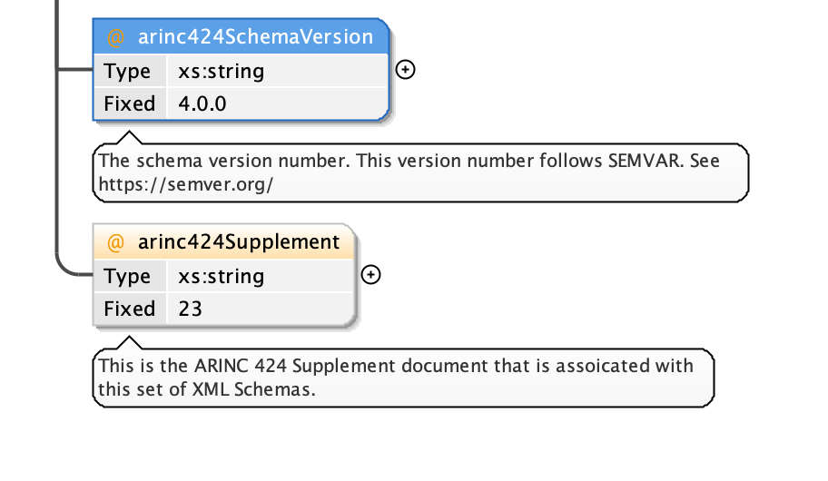
Supp23
We published a few hotfixes to Supp23 XML Schemas
Led to version number confusion:
I added an ARINC 424 Supplement field to link the versions to the paper documents in 4.0.0

Slide 4
Supp24
PR in for all changes from last NDB
This is/will-be released as Supp24_Draft1
https://git.codev.mitre.org/projects/ARINC/repos/arinc424schemas/pull-requests/170/overview

Slide 5
Versioning
To date we have been following
SEMVER & Page-340
The result was that the major version number updated when people did not expect it in Supplement 23
The minor description also needs work

Slide 6
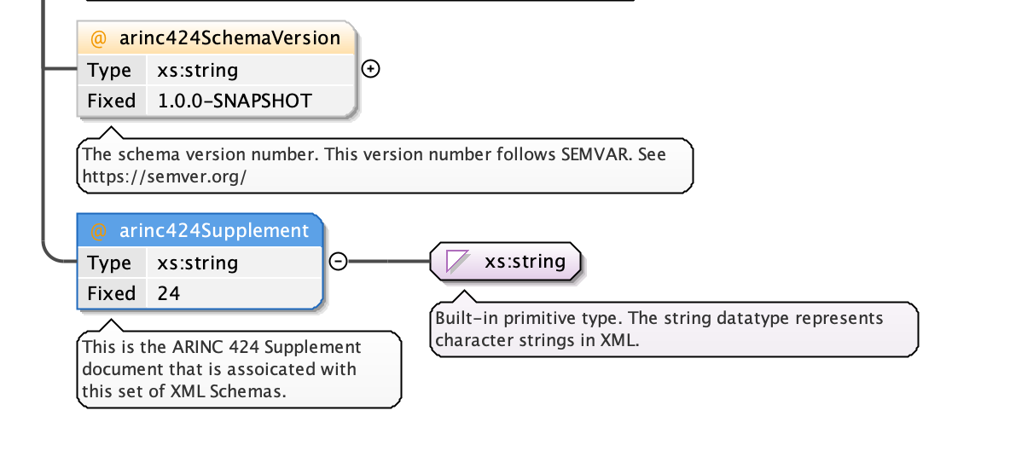
Versioning
Current metadata
MAJOR version when you make incompatible API changes
MINOR version when you add functionality in a backward compatible manner
PATCH version when you make backward compatible bug fixes
We need to decide if we want to reset the version number for Supplement 24

Slide 7
Expectations
We should not “have” to change the published schema at all if we were mistake free
Supp24 -> v1.0.0 would ideally be the only version
Most changes are going to be Major
Minor is going to be rarely seen
I need the patch version to cover administrative mistakes that drive a re-release
E.g., manual process to generate documentation from schemas = I might leave a file out or something

Slide 8
Summary
Supp23 released with hotfixes
Supp24 draft 1
Versioning

