Slide 1
ARINC Airline Electronic Engineering Committee (AEEC) Systems Architecture and Interfaces (SAI) Subcommittee Global Aircraft Tracking Team Telecon November 01, 2017 Rev NEW
Charles Adler, Project Engineer
Boeing Commercial Airplanes, Avionics
(charles.o.adler@boeing.com)
Cell: 206-578-2533
Peter H. Grau
Principle Engineer,
ARINC Industry Activities

Slide 2
11/01 Agenda
Intro/plan/status
Hamburg Planning
Architecture Teams Updates/Discussions
429 Trigger Label discussion
Questions/Discussions?

Slide 3
ADT Architectural Phase Schedule
Oct (AEEC Mid term)
Phase 1 requirements report out (Jessie Turner)
Nov GAT team face-to-face
Nov 14 ICAO GADSS member informal discussions
Hamburg reminder:
Airbus security info
ARINC registration
GAT face-to-face Seattle
August 16-18
DRAFT WP Pre-req,
ICAO dis Prep
Req prep,
ICAO discussions report
GAT face-to-face Hamburg
November 7-9
(architecture study)
SEA/Plan RECAP
Min Req
Req & WP Template
WP Template and Teams
Ongoing reviews, discussions
8/23
8/30
9/6
9/13
9/20
9/27
10/4
10/11
10/18
10/25
11/1
Analysis, Prioritization/
Relationships

Slide 4
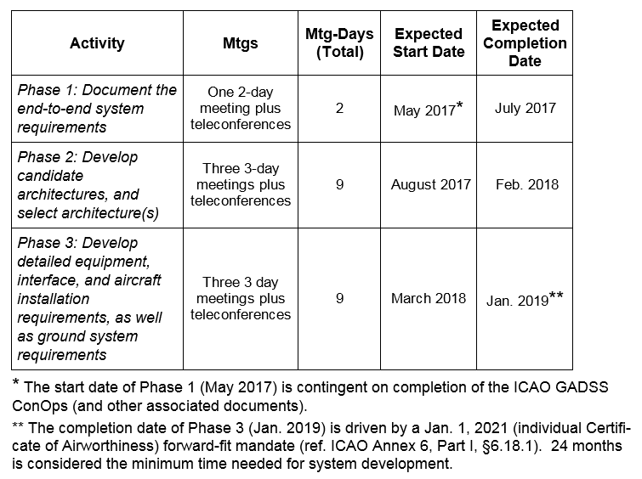
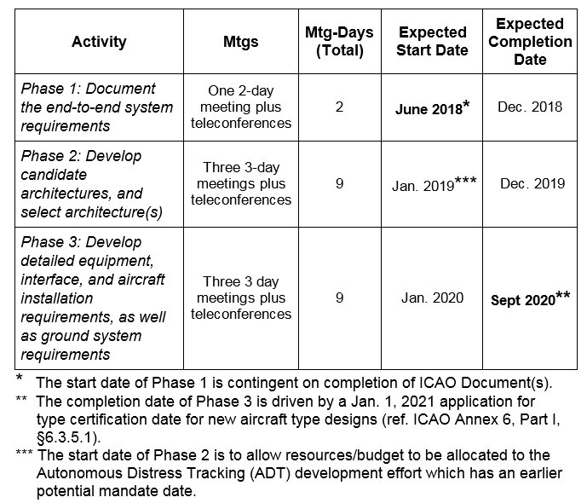
APIM 17-004 Autonomous Distress Tracker
APIM 17-005 Timely Recovery of Flight Data
2016
2017
2018
2019
2020
2021
J F M A M J J A S O N D
J F M A M J J A S O N D
J F M A M J J A S O N D
J F M A M J J A S O N D
J F M A M J J A S O N D
J F M A M J
ARINC AEEC
ARINC AEEC Autonomous Distress Tracker (ADT)
(APIM 17-004)
Timely Recovery of Flight Data (TRFD)
(APIM 17-005)
AEEC Mid Term Session
APIMs Submitted
AEEC General Session
ARINC APIMs Approval
AEEC Mid Term Session
ADT Phase 1 Report Out
AEEC General Session
ADT Phase 1 and 2 Report Approval
AEEC General Session
ADT Characteristics Approval
TRFD Phase 1 Report
AEEC General Session
TRFD Phase 1 and 2 Report Approval
AEEC Mid term Session
TRFD Characteristics Approval
ADT Phase 1 (Requirements) Pre-Meeting
ADT Phase 1 (Requirements)
ADT Phase 2 (Architecture Selection)
ADT Phase 3 Develop ARINC Characteristic(s)
ICAO ADT Production Applicability
ADT EIS
TRFD Phase 1 (Requirements)
TRFD Phase 2 (Architecture Selection)
TRFD Phase 3 Develop ARINC Characteristic(s)
ICAO TRFD New Type Cert Applicability

Slide 5
Upcoming Meeting Schedules/2018 Look-Ahead
1.) Nov 7th-9th 2017 face-to-face GAT meeting to work architectural studies: (Airbus, Hamburg).
2.) Nov 14, 13:00 non-ARINC meeting with ICAO GADSS Advisory Group (Montreal), discuss our work, issues, gaps, 10054 document.
3.) Feb 6, 7 2018 (in planning)– face-to-face GAT meeting to finalize architectural study, start characteristic development – Florida, Gables Engineering, Coral Gables
(SAI meeting, same location 8th & 9th Feb) .
Potential Face-to-face mtgs
ADT Characteristic Completion
Submitted to ARINC
JAN 2019
Gables Engineering,
Coral Gables FL
ADT Characteristic Completion
Stretch?
SAI+GAT
Memphis., TN
Aug?
FEB 6,7
Inmarsat
London
GAT JUNE 12-13?
Skytrac
Kelowna, BC
2018
JAN
FEB
MAR
APR
MAY
JUN
JUL
AUG
SEPT
OCT
NOV
DEC
JAN
Characteristic Start
Report Approval
TRFD REQ Start
TRFD REQ Finish
TRFD ARCH Start
Report Submitted
APR 23-26
MAR 15
AEEC GEN SESSION
Dallas Tx

Slide 6
Hamburg Agenda
November 7-8, 2017 from 0900 to 1700
November 9, 2017 from 0900 to 1300
Attendee List
ADLER, Charles BOEING
ALVEZ, Luis EMBRAER AIRCRAFT CORP
GRACOM, Todd BOEING
GRAU, Peter SAE ITC, ARINC IA
GRIEBEL, Hannes INMARSAT
HAYOSH, Timothy AMERICAN AIRLINES
MENARD, Frederic OROLIA
OERTER, Christian LUFTHANSA
PACK, Thomas ACR ARTEX
PICHAVANT, Claude AIRBUS
RAINFORD, Paul SITAONAIR
RATHNAM, Vijay PANASONIC
SENOL, Ahmet AIRBUS
SMITH, Greg NTSB
STEPIN, Ruben SKYTRAC SYSTEMS LTD
THOMPSON, Brad ROCKWELL COLLINS
 | Architectures/Focus | Leads
 | Inro/planning |  | TUES
 | ELT-DT & COSPAS SARSAT, deployable beacons | Tom Pack? (Deployable Beacons – Claude or Ahmet?) | TUES
 | SATCOM (INMARSAT) | Hannes Griebel, Chuck Adler? | TUES
 | SATCOM (Iridium) | Vijay Rathnam ? | TUES
 | Integration work | all | TUES
 | Space-Based ADS-B | Jessie Turner, (Virtual?) | WED
 | Dissimilar-complimentary/minimal change approaches | Hannes Griebel, Chuck Adler?, | WED
 | Integration work | all | WED
 | Detection/trigger architecture | Luis? Chuck? Virtual? | WED/THURS
 | Airplane Integration (mechanical/structural, electrical, data) | Todd Gracom? | THURS
 | Integration work/Close-Out | all | THURS
Web-EX – TBD – if connectivity is available we will have a standing web-ex for remote attendees
New section: airframer perspective on architecture? – others?
Any Industry perspective presentations?

Slide 7
Architectures Teams to date
 | Architectures/Focus | Leads | Members
1 | Implementation Architectures
1.1 | ELT-DT & COSPAS SARSAT, deployable beacons | Tom Pack, Todd Gracom | Ahmet Senol, Fadl Khalil, Frédéric Menard, Joseph Bekanich, Iain Ronis
1.2 | SATCOM (INMARSAT) | Hannes Griebel, Claude Pichavant? | Ahmet Senol, Chuck Adler/Jessie Turner?, Lars Rosenblad, Kent Jacobs, Iain Ronis
1.3 | SATCOM (Iridium) | Matt Drummond, Mike Ball, Bill Bergh, Vijay Rathnam | Claude Pichavant, Ahmet Senol?, Chuck Adler/Jessie Turner? Skytrac, Lars Rosenblad, Kent Jacobs, Charles Noble, Michael Hooper, Joseph Bekanich, Ruben Stepin, Iain Ronis, Sacha Whitehead, Mark Insley
1.4 | Space-Based ADS-B | Jessie Turner, Christophe Hamel?, | Chad Brown, Claude Pichavant, Paul Rainford, : Ruben Stepin, Vinny Capezzuto, Iain Ronis, Tim Hayosh, Michael Garcia
1.5 | Dissimilar-complimentary/minimal change approaches | Chuck Adler, Hannes Griebel | Christophe Hamel, Matt Drummond, Bill Bergh, Vijay Rathnam, Lars Rosenblad, Joseph Bekanich, Ruben Stepin , Sacha Whitehead, Brad Thompson
1.6 | Detection/trigger architecture | Roberto Pereira, Chuck Adler | Chuck Adler, Jessie Turner, Ahmet Senol?, Luis Alves?, Fadl Khalil, Todd Gracom?, Fadl Khalil, Luis Alves?, Lars Rosenblad, Joseph Bekanich, Ruben Stepin , Mike Ball, Iain Ronis, Brad Thompson
2 | Integration Architectures
2.1 | Airplane Integration (mechanical/structural, electrical, data) | Roberto Pereira, Todd Gracom, | Hannes Griebel, Skytrac, Charles Noble, Chuck Adler, Jessie Turner,Luis Alves, Chuck Adler, Vijay Rathnam, Joseph Bekanich, Ruben Stepin , Mike Ball, Iain Ronis
2.2 | Forward-fit (new production) | Claude Pichavant (move to 2nd iteration) | Ruben Stepin , Mike Ball
2.3 | Retrofit (existing fleets) |  | Ruben Stepin
2.4 | Air-Ground Data Interface |  | Ruben Stepin , Sacha Whitehead,
2.5 | AOC/Airline Operator Integration |  | Ruben Stepin , Sacha Whitehead,
2.6 | ADT Operator Integration |  | Sacha Whitehead,
2.7 | Operator Implementation |  | Ruben Stepin

Slide 8
ARINC 429 Label
Notes from several weeks ago:
Update from Peter: An APIM is being brought into the SAI Executive Committee in Brussels to re-open the ARINC 429 specification to add new labels, here is Peter’s summary of this:
“The scheduling for this will be similar to the GAT Working Group’s schedule. That is, the completed A429 document must be presented to the Executive Committee for approval at the General Session, April 23-26, 2018. The A429 document must be circulated for 30 days prior to that for community review/comment/objection. This implies the A429 must be completed by about March 15th. We therefore should have our material to Jose no later than February 28, 2018 for inclusion with other new labels, approximately 4 ½ months from now.
We should provide the completed request to Jose as soon as we have it, and it will be posted on the ARINC website until the document is completed and approved. Once the document is published, the label will become a permanent addition to the A429 library.”

Slide 9
Discussions/Questions?

