Slide 1
Global Aircraft Tracking Working Group SAI Subcommittee
Jessie Turner
AEEC SAI/Executive Committee
The Boeing Company
AEEC General Session
April 24, 2018
Chuck Adler – GAT WG Chairman
The Boeing Company
Peter H. Grau – Secretary
ARINC Industry Activities

Slide 2
Overview
Autonomous Distress Tracking (ADT) activities in-work per APIM 17-004. Supports Jan. 1, 2021 forward-fit ICAO and European Union mandates
Timely Recovery of Flight Data (TRFD) planning activities have initiated per APIM 17-005. Supports Jan. 1, 2021 ICAO mandate for new Type Cert applications
ADT Phase 1: Initial Requirements - Complete
ADT Phase 2: Proposed Architectures - In-Progress (ECD Oct. 2018) with Architecture Teams developing architectures for:
Emergency Locator Transmitter – Distress Tracker (ELT-DT)
Spaced-Based Automatic Dependent Surveillance – Broadcast (SB ADS-B)
SATCOM-based (Inmarsat & Iridium) Trackers
Dissimilar-complimentary/minimal change approaches
ADT Phase 3: Detailed Aircraft Interfaces & Installation Requirements (ECD Jan. 2019)

Slide 3
2017-2018 Activity and Accomplishments
Issued two drafts of Project Paper 680 (Architectures Report)
Five face-to-face meetings:
June 2017 – Denver (Panasonic)
August 2017 – Seattle (Boeing)
November 2017 – Hamburg (Airbus)
February 2018 – Miami (Gables Engineering)
April 2018 – London (Inmarsat)
Weekly WebEx meetings
Five Architectural Working Groups developing details
Participation of 22 organizations across (2) airlines, (12) suppliers, (3) airframers, (3) service providers, NTSB, and FAA
Harmonization efforts with EASA, BEA, and others

Slide 4
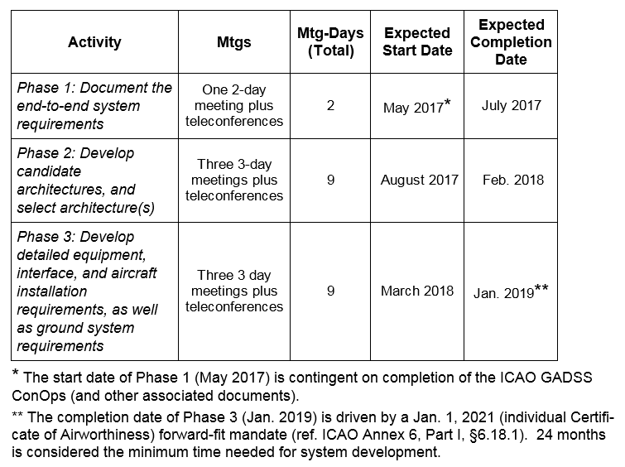
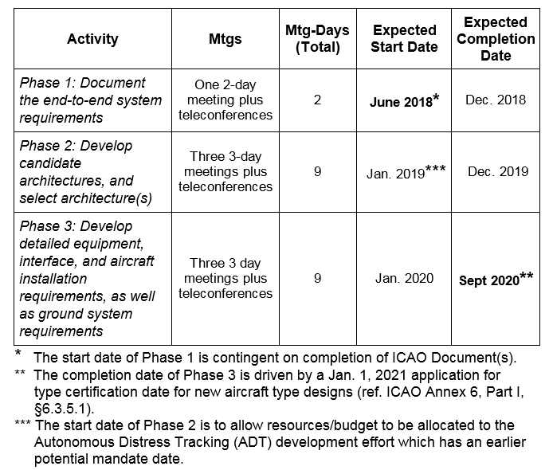
Project Schedule Overview
APIM 17-004 Autonomous Distress Tracker
APIM 17-005 Timely Recovery of Flight Data
Complete
Oct.
2018
2016
2017
2018
2019
2020
2021
J F M A M J J A S O N D
J F M A M J J A S O N D
J F M A M J J A S O N D
J F M A M J J A S O N D
J F M A M J J A S O N D
J F M A M J
ARINC AEEC
ARINC AEEC Autonomous Distress Tracker (ADT)
(APIM 17-004)
Timely Recovery of Flight Data (TRFD)
(APIM 17-005)
AEEC Mid Term Session
APIMs Submitted
AEEC General Session
ARINC APIMs Approval
AEEC Mid Term Session
ADT Phase 1 Report Out
AEEC General Session
ADT Phase 1 and 2 Report Approval
Mid-Term Session
AEEC General Session
ADT Characteristics Approval
TRFD Phase 1 Report
AEEC General Session
TRFD Phase 1 and 2 Report Approval
AEEC Mid term Session
TRFD Characteristics Approval
ADT Phase 1 (Requirements) Pre-Meeting
ADT Phase 1 (Requirements)
ADT Phase 3 Develop ARINC Characteristic(s)
ICAO ADT Production Applicability
ADT EIS
ADT Phase 2 (Architecture Selection)
TRFD Phase 1 (Requirements)
TRFD Phase 2 (Architecture Selection)
TRFD Phase 3 Develop ARINC Characteristic(s)
ICAO TRFD New Type Cert Applicability

Slide 5
Detailed Near-Term Schedule
ADT Detail Char. Completion
Submitted to ARINC
JAN 2019
Inmarsat
London
FEDEX
SAI+GAT
Memphis
Skytrac
Kelowna, BC
Inmarsat
Hawaii
Oct 23-25
Iridium
Wash DC
Dec 4-6
APR 10,11,12
JUNE 11-13
August 21-23
Meetings
2018
MAR
APR
MAY
JUN
JUL
AUG
SEPT
OCT
NOV
DEC
JAN
ADT Standards
Start
APR 23-26
AEEC GEN SESSION
Requirements and Architectural Report Submitted
Arch Report Approval
TRFD REQ Finish
TRFD ARCH Start
AEEC Mid-Term SESSION
MAR
APR
MAY
JUN
JUL
AUG
SEPT
OCT
NOV
DEC
JAN
FEB
Review updates, Doc 10054, updates
Gen edit/arch updates
Team reviews, integration and refinement
Final updates, team edits, SAI edits/input
SAE/ ARINC Edit and Release
ADT Reqts and Arch Report Timeline
draft 2
draft 3
Final draft
REV NEW
ADT Detailed Characteristics (Interfaces, Power, Form Factor) Timeline
Common interface list, draft straw horse and assumptions
By-architecture Interface Proposals
Cross-architecture Interface Integration
Integration and Refinement
Integration and Refinement, SAI, External Reviews
SAE/ ARINC Edit and Release
draft 1
draft 2
draft 3
draft 4
Final draft

Slide 6
Industry/Regulatory Related Time Lines
2010
2011
2012
2013
2014
2015
2016
2017
2018
2019
2020
ICAO Annex
6 ,11
ADT,
TRFD
LF-ULD Mandates
Normal Tracking Mandates
EU Regulation 2015/2338
Location of A/C in Distress
ICAO GADSS CONOPS V6
18 months!
ICAO 10054
ICAO Annex 6
EASA CS, AMC/GM for ADT
Jan 2021 ADT Mandates
90 day ULBs
LF-ULD
DOES NOT SUPPORT JAN. 2021 MANDATE IMPLEMENTATION
(Min. 30 months required)
TSO-C142a
(NRLB)
2008
ED-237
Distress Trigger MASPS
FAA
NRLB
SC, MOC
DO-227A
NRLB MOPS
ED-62
ELT-DT
MOPS
(SC-229)
International Regulator
SARPS, Rules and Mandates
TSO-142B
NRLB
Industry
Distress Tracking Related Requirements
NRLB – Non-Rechargeable Lithium Batteries
ULB – Underwater Locator Beacons
LF-ULD – Low-Frequency-Underwater Locating Device
Regulator and Industry
Lithium Battery Requirements

Slide 7
Risks and Issues
Extremely tight schedule, but feasible for standards development
Outstanding requirements and guidance from ICAO/Regulators – potential for late breaking requirements requiring implementation updates close to regulation dates:
ICAO Doc. 10054 (ECD May 2018)
EASA Certification Specifications (CS), Acceptable Means of Compliance (AMC), Guidance Material (GM) (ECD June 2019). Doesn’t support a Jan. 2021 forward-fit implementation! Minimum of 30 months required from release of EASA CSs and AMC/GM.
Outstanding GADSS distress data repository ownership and implementation
Impact of new lithium battery regulations on meeting autonomy requirements and on certification time flows

Slide 8
Thank You! Questions / Comments?

