Slide 1
ARINC Airline Electronic Engineering Committee (AEEC) Systems Architecture and Interfaces (SAI) Subcommittee Global Aircraft Tracking (GAT) Team Telecon November 07, 2018 Rev A (with Notes)
Chuck Adler
Project Engineer
Boeing Commercial Airplanes, Avionics
(charles.o.adler@boeing.com)
Cell: +1 206-578-2533
Peter H. Grau
Principal Engineer,
ARINC Industry Activities
<Peter.Grau@sae-itc.org>
https://www.aviation-ia.com/activities/global-aircraft-tracking-gat-working-group

Slide 2
Agenda
1.) Schedule/Planning Look-Ahead, TRFD updates
2.) Face-to-face recap/follow-up
1.) Key materials on sharepoint
2.) question on RCC references
3.) South African RCC discussion (Paul)
3.) ELT Discussions
4.) Interfaces updates and next steps
5.) 680 Draft Document Updates/Plans
6.) Risk/concerns inputs to EASA/ICAO discussion/draft
- Embraer frame-work white paper (Roberto)
3.) Around the Room (Mark)

Slide 3
Upcoming Meeting Schedules/2018/2019 Look-Ahead
TRFD REQ Start
FEDEX
SAI+GAT
Memphis., TN
TRFD ARINC 681 report now an integrated requirements, architecture and proposed standards report
Skytrac
Kelowna, BC
Inmarsat
Hawaii
(Honolulu area)
Oct 24-26
Iridium
WA DC Area (Leesburg, VA),
ARINC 680
Submitted to ARINC
JAN 2019
Inmarsat
London
GAT JUNE 11-13
August 21,22,23
APR 10,11,12
Dec 4, 5, 6 (+7)
IQPC - 2th Flight Location and Data Recovery 11- 13 September 2018 - Hamburg, Germany
TRFD Strawhorse #1
February
(following FL meeting)
2018
EASA Aircraft In Distress End Users Workshop
EASA Location Of Aircraft In Distress Enablers Workshop 9/10 – Cologne, Germany
MAR
APR
MAY
JUN
JUL
AUG
SEPT
OCT
NOV
DEC
JAN
NEW
TRFD ARCH Start
Characteristic Start
APR 23-26
AEEC Mid-Term SESSION (10/14)
TRFD REQ Finish
GAT WG will present one completed document for approval at the General Session in April 2019 (in Prague).
There will be a GADSS symposium at the general session as well: Jessie Turner hosting, Airbus, Boeing, Skytrac, ACR presenting
AEEC GEN SESSION
Dallas Tx
MAR
APR
MAY
JUN
JUL
AUG
SEPT
OCT
NOV
DEC
JAN
FEB
ARINC 680
ADT Interface Standards Section
common interface list, draft straw horse and assumptions
Interface refinement, by-architecture scrubs/discussion and cross architecture integration
Integration and refinement
Integration and refinement, SAI, external reviews
SAE/ARINC edit and Release
draft 3 to AEEC
Final draft
MAR
APR
MAY
JUN
JUL
AUG
draft 2 to AEEC 10/8
move to after WA DC face-to-face meeting
ARINC 680
ADT Requirements and Architecture Report Sections
Review updates, Doc 10054, updates
Gen edit/arch updates
Team reviews, integration and refinement
Final updates, team edits, SAI edits/input
2019 meeting/presentation plan:
1.) February co-located SAI-GAT: 4-6 GAT, Feb 7-8 SAI: Coral Gables Florida, USA, Gables Engineering
2.) April,: GAT only meeting: April 2-4, Pretoria/Johannesburg area, South Africa: SatAuth
3.) April: IATA Safety and Flight Ops Conference 2019: April 2-4, potential GADSS presentation (Airbus Claude)(https://www.iata.org/events/Pages/ops-conference.aspx)
4.) April: AEEC General Session (Prague) April 29 – May 2 (<https://www.aviation-ia.com/conferences/aeec-general-session>) GADSS symposium
5.) June co-located SAI-GAT: June 17-19 GAT, June 20-21 SAI: Toulouse France, Airbus
6.) August GAT only - Boeing Seattle
Strawhorse updates
Draft 1 to AEEC

Slide 4
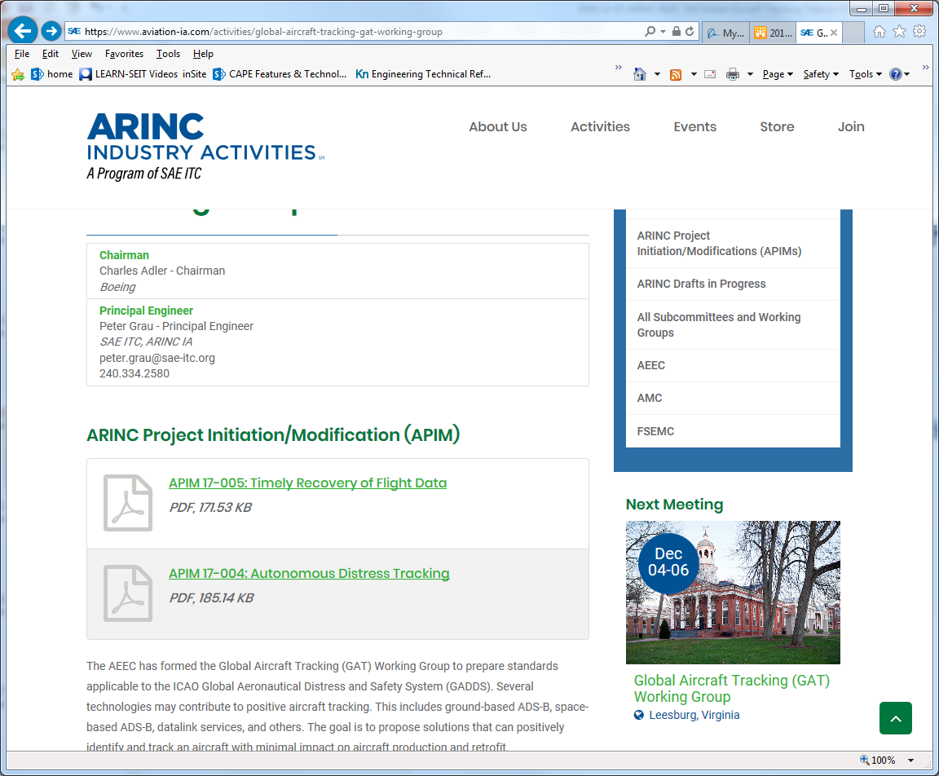
WA DC Face-to-Face
December WA DC Meeting Announcement:
https://www.aviation-ia.com/sites/default/files/media-files/GatAnnounceDec18.pdf
For international attendees – please get your info for the NASA SARSAT and NOAA/US-MCC tour registrations into George this week – we are right on edge or time needed to process these
US attendees should do so this week as well but there may be a little more latitude here.
The reservation deadline for the hotel special rate is Monday November 19, 2018.
February 2019 Coral Cables Meeting Announcement:
https://www.aviation-ia.com/sites/default/files/media-files/GatAnnounceFeb19.pdf

Slide 5
Face-to-Face Recap/Follow-Up

Slide 6
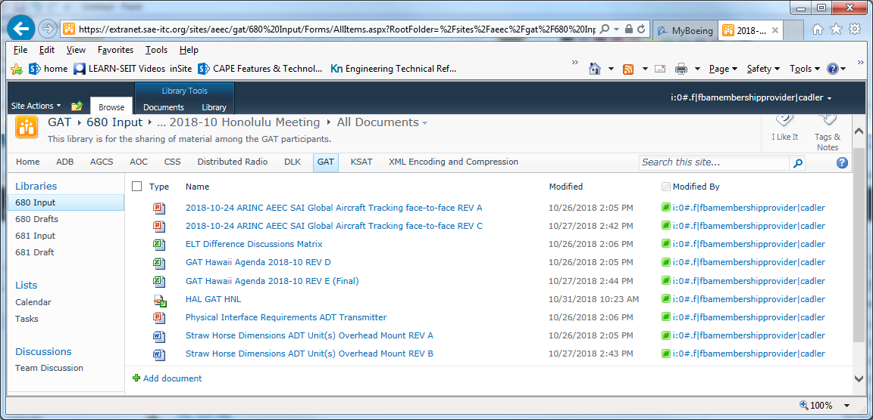
October Face-to-Face Material on Sharepoint
GAT -> 680 Input -> 17.) Meeting Archives -> 2018-10 Honolulu Meeting
Final notes
Hawaiian Airlines Presentation
Airbus ADT Transmitter physical envelope/footprint/connector inputs
Boeing ADT Transmitter physical envelope/footprint inputs

Slide 7
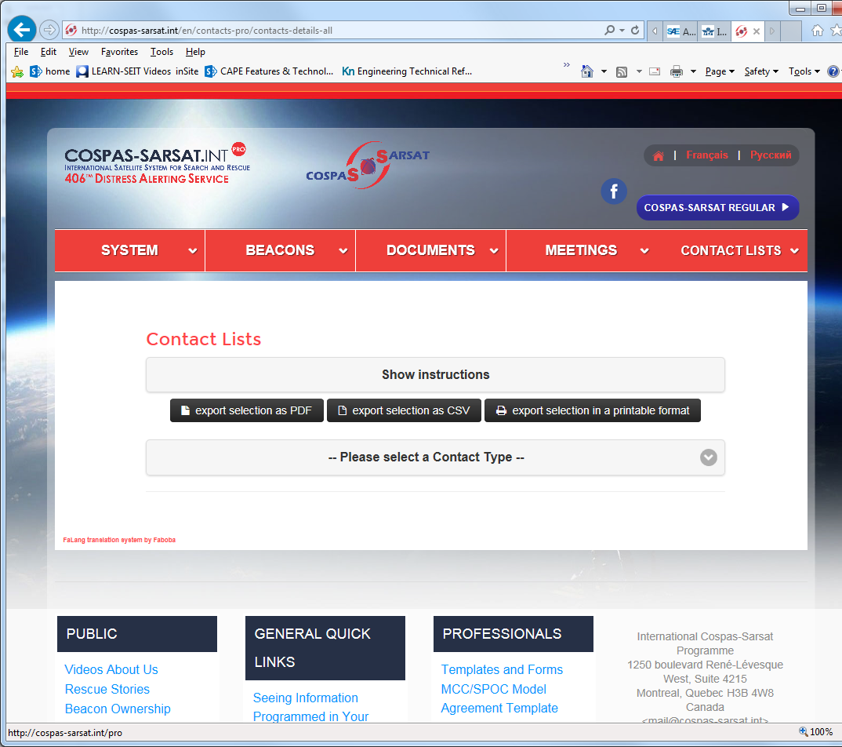
Question: are there publicly available registries or reference sources of Rescue coordination centers and/or air traffic service units and their areas of responsibility?
Input from George Theodorakos:
Volume 5 (NP285) - Global Maritime Distress and Safety System (GMDSS) published by Admiralty Maritime Data Solution
There is a list of Cospas-Sarsat SPOCs and RCCs on the C/S website. The URL is: http://cospas-sarsat.int/en/contacts-pro/contacts-details-all
The sequence to get there is SYSTEM->MCC Details->MCC Contact Information, and then in the drop down under Contact Type select SPOCs.

Slide 8
Inputs from Paul on discussions with South Africa (SA) RCC
Location: Cape Town
LUT/MCC is hosted by local telecom company, this is a largely automated node, with actual evaluation/validation/response taking place at RCC which is combined Maritime and Aviation RCC (MRCC + ARCC).
SA MRCC/ARCC covers extensive area: east coast/Tanzania to west coast/Angola and south to the oceanic lanes below South Africa.
Close ties to Australian RCC
SA RCC verifies even the shortest/ most transient of non-responsive COSPAS-SARSAT activations.
SA RCC: 2 responders 24/7/365, extensive graphics and communication facilities, extensive capability to monitor shipping lanes.
SA RCC has agreements/comms that support getting nearby shipping to support response may shorten times.
For incidents 7 NM offshore – 3-5 hour response times, 100 NM off shore, ~3 day response time.
RCC is seen as appropriate place for DTR interface – preferred approach is DTR tracking terminal or application.

Slide 9
Major Discussion: ELT Types Supported by ED-62B MOPS and C/S specs
Hybrid ELT is not a defined configuration and will be replaced in report:
ELT Types supported by MOPS and C/S (excepting portables): The major implication is that these are the types with defined certification requirements and will be the types supported in TSOs/ETSOs:
ELT (AF) (automatic fixed)
ELT (DT) (distress tracking) – meets ICAO requirements with suitable triggering capability (expected to be external)
- ELT (DT) with crash survivability – meets ICAO and EASA requirements (for 1st gen Beacon with integral GNSS or for 2nd Gen beacon) with suitable triggering capability (expected to be external) and crash detection
ELT (AD) (automatic deployable) - meets ICAO and EASA requirements (for 1st gen Beacon with integral GNSS or for 2nd Gen beacon) with suitable tracking capability and triggering capability (expected to be external) and crash detection
Other notes: current MOPS replace G-Switch with “crash detection” to allow for updated technologies (e.g. MEMS accelerometers, GNSS data etc…) that address issues with mechanical G-Switch configurations
Next steps:
Report architecture section and complementary/Dissimilar architecture section will reflect configurations currently defined in specs.
As part of discussions options (TBD which section) potential benefits and characteristics of a combined EL(DT)/ELT(AF) will be discussed.
TBD if there is consensus that this combined EL(DT)/ELT(AF) is something that will be recommended by this group for further development.
Any further work with regulators to define and include this combined EL(DT)/ELT(AF) configuration would be pursued outside of ARINC effort.
Definition from C/S T.001:
ELT(DT)s Specifically Designed to Withstand a Crash Impact
4.5.10.1 Introduction
Potentially there may be ELT(DT)s that have additional functionality, as defined by National Administrations and/or Aviation Authorities, which are designed to:
1) function both prior to a crash and after a crash, and withstand crash impact conditions;
2) be activated in-flight or by crash;
3) have homing and locating signals; and/or
4) have extended operating life.
If there is a conflict between the requirements of this section and any other section of this document, then this section takes precedence.
4.5.10.2 Beacon Hex ID
The Hex ID of the ELT(DT) shall not change from when activated in flight compared to when operating after a crash.
4.5.10.3 Burst Repetition Period (with Crash Detection)
If the ELT(DT) includes a crash detection function, within 5 seconds of a crash the ELT(DT) shall restart the transmission schedule for an ELT(DT) as if the ELT(DT) had just been activated.
4.5.10.4 Duration of Continuous Operation
The minimum duration of continuous operation for this type of ELT(DT) shall be at least 24 hours at any temperature throughout the specified operating temperature range. This is to be understood to mean the total operating time which is a combination of the time prior to a crash and post-crash.
4.5.10.5 Homing and Locating Signals
The inclusion or otherwise of one or more homing signals in the ELT(DT) and the activation and duration of any homing signal transmissions are the responsibility of national administrations.

Slide 10
ADT Interfaces Straw Horse Current Status (1 of 2)
Interfaces version worked during meeting:
GAT -> 680 Input -> 16.) ADT Interfaces and ARINC 429 Labels/ -> Strawhorse Interface Definitions -> Current Working Version ->
Interface definitions (version 2m).xls
Scope and intention of physical interface recommendations (from face-to-face meeting):
1.) The intent for these physical interface recommendations is to provide guidance on physical constraints where these do not already exist, if an architecture implementation is using current specs (e.g. ARINC 771, 781) then these interfaces would be “n/a” for that architecture in the A680 with a reference to the spec used. If an architecture is implemented in existing units (e.g. Inmarsat satcom, ADS-B Out architectures) then interfaces are be “n/a”. If architecture specific team decides that due to variability etc this is not practical or is not useful then this could be “n/a” for that architecture (physical interfaces for other architectures could still provide useful guidance in this case for individual developers or implementers looking for such guidance).

Slide 11
ADT Interfaces Straw Horse Current Status (2 of 2)
Face-to-face: Boeing and Airbus volume and footprint inputs for ADT transmitter (overhead mount), also proposed as inputs for overhead mount ADT module if this is implemented as a stand-alone overhead mount unit
Next steps (goals as input to WA DC meeting)
Overhead option: other OEM inputs as available, Boeing connector inputs, integrated OEM inputs
OEM inputs on non-overhead options (?)
By architecture inputs (minimum goal: are OEM constraints workable/will they result in design changes (risk/concern area with current schedule etc…), desired goal: cross supplier supportable constraints) – goal both overhead and rack mount options if needed
Proposed close-out:
Cooling air for overhead mount – passively cooled (is there any need for cooling air for rack mount options)
Grounding and bonding – proposed n/a – per existing industry or aircraft requirements,
Request input following telecon:
“but would it be possible in the A680 to standardize the labels for Latitude/Longitude/Altitude coming from Avionics?
What I mean by that is to have a single label number XXX for these 3 parameters to avoid multiple firmware configurations for the ADT transmitter.”

Slide 12
Document 680 Draft 2 Release/Draft 3 Plans
Draft 2 A680 Circulation Copy
Draft 2 A680 Circulation Copy
A680 Draft 3 on the Sharepoint
GAT -> 680 Input -> 04.) ADT Requirements and Architectures Report -> Draft 03
A680 Base Document Draft 3 Start.doc (same as A680 Base Document Draft 2.doc above)
Copy start document, makes changes with changes tracked, avoid section replacements unless absolutely needed – send updates (as marked up document or notes) to Chuck for incorporation into master (updates will be posted periodically similar to draft 2)
Updates proposed for Draft 3 (Nov/Dec timeframe)
1.) additional internal/external inputs incorporated
2.) further clean-up/editing
3.) all interface at generic/strawhorse level, majority at by architecture reviews complete
4.) summary of draft EASA CPOs with high level discussion (requirements section), EASA schedule
5.) EU TCO summary
6.) refined summary and conclusions (near final) – summaries of requirements (EASA/ICAO inputs,
by-architecture summaries, interface recommendation discussion)
7.) inputs from recent discussions
a.) power duration update, including Cospas-Sarsat requirements, survey of avherald data
b.) operator perspective (from Norlinor discussion, slides)(in airplane integration section)?
c.) nuisance rate discussion
8.) ADS-B updates (Jessie’s working paper proposals etc…)(see 10/10 notes for details)
9.) Other?
Look Ahead updates proposed for Final draft (Jan timeframe)
1.) additional internal/external inputs incorporated
2.) ELT ED-62 (for final draft) sync with as-released ED-62
3.) Updates to reflect any EASA releases
4.) Updates to reflect any ICAO material (10054 updates/releases etc..)

Slide 13
Major Discussion: Risks, Recommendations
1.) The possibly largest risk faced in ADT implementation is the potential split between EASA and ICAO requirements and timelines: The EASA requirements are potentially significantly more rigorous than the ICAO requirements (DAL C, Crash Survivability) and potentially have an implementation date of 2023. The ICAO SARPS do not include these requirements but are likely to hold to the 2021 implementation date. The industry will be very hard pressed (resource wise and in an economically feasible manner) to develop a set of ICAO compliant systems for 2021 and then a set of EASA compliant systems for 2023. This effectively could result in a need to effectively develop EASA compliant system to the ICAO SARPS timeline – which is extremely challenging and is probably not realistic.
“CPO-17: The design reliability of the airborne equipment used by the system should be such that the rate of nuisance activations (disregarding manual activations) is less than 2E-5/FH (corresponding to Major severity
classification).”
“5. CPO-17: does this imply a DAL and which one?
a. Post-meeting: the DAL should be commensurate to the nuisance rate objective i.e. DAL C.
b. Note: this DAL only is applicable to those components which contribute to the nuisance rate, and the design of the LAD system may foresee an architecture where the transmission is of a lower DAL (DAL D).”
Discussion and recommendation on the application of DAL level to the distress logic nuisance alert rate requirement.
Background:
The ED-237 MASPs does not use the term Major with respect to the nuisance alert rate. ED-237 focuses on the SAR preferred 2x10^-5/FH rate and a logic contribution rate of less than 1x10^-5/FH and intentionally stayed away from discussing or applying a DAL level to either the system or the logic as outside of the scope of the document as this should be determined by the airplane level hazard assessment.
In the draft CPOs and following discussions there has been an evolution of the requirement of1x10^-5/FH for the logic to a major level classification (CPO-17) to a DAL C expectation (follow-on discussions).
Our recommendation is not to increase the existing DAL levels and maintain a focus on the achieving the required nuisance alert rate:
1.) The DAL Level should be out of the scope of this requirement and should be determined by the airplane level hazard assessment (This situation is similar to the current approach taken for SATCOM systems which are DAL level D).
2.) The current ELT is a Minor level specification (and understood by industry as a DAL D device) and this should be maintained for the ADT transmitter functionality (for example the ELT (DT)).
3.) The focus should be maintained on ensuring that the distress logic meets the required nuisance rate; focusing resources on rigorous analysis of logic (e.g. FMEA) and use of simulations and other means to validate the logic within representative environments will be a much more effective application of effort than the application of more general process associated with a higher DAL.
Walk-through of Embraer white paper “Nuisance discussion and framework_rev3.doc” posted on sharepoint at: GAT -> 680 Input -> 17.) Meeting Archives -> Telecons -> Nuisance discussion and framework_rev3.doc

Slide 14
Around the Room
Ground Based ADS-B data discussion:
link to the flight: https://flightaware.com/live/flight/LNI610/history/20181028/2310ZZ/WIII/WIKK
the tracklog discussed: https://flightaware.com/live/flight/LNI610/history/20181028/2310Z/WIII/WIKK/tracklog
No updates on EASA request to EU commission for ADT implementation schedule update

