Slide 1
ARINC Airline Electronic Engineering Committee (AEEC) Systems Architecture and Interfaces (SAI) Subcommittee Global Aircraft Tracking (GAT) Team Telecon February 13, 2019 REV A (Notes)
Chuck Adler
Project Engineer
Boeing Commercial Airplanes, Avionics
(charles.o.adler@boeing.com)
Cell: +1 206-578-2533
Peter H. Grau
Principal Engineer,
ARINC Industry Activities
<Peter.Grau@sae-itc.org>
https://www.aviation-ia.com/activities/global-aircraft-tracking-gat-working-group

Slide 2
Agenda
02.) References (ICAO GADSS CONOPS etc.)
1.) Schedule, Recap, South Africa Draft Agenda (15 min)
2/20 telecon schedule: antenna interface discussions, RCC take-aways discussions, draft report discussions.
2.) Draft A680 Report Updates (40 min)
4.) Round-the-Room (5 min)

Slide 3
Upcoming Meeting Schedules 2019 Look-Ahead
1/9 – 4/24 Weekly telecons (subject to adjustment)
1 every 3 week ADT telecons coordinated with 1 every 3 week TRFD telecons
Web-ex invite sent
Boeing
Seattle
1st ½ of Aug
(are there conflicting dates in Aug?)
Inmarsat
Hawaii
(Honolulu area)
Oct 24-26
Iridium
WA DC Area (Leesburg, VA),
Gables Engineering
Coral Gables Florida
SatAuth
Johannesburg SA
AEEC General Session
Airbus Toulouse
Dec 4, 5, 6 (+7)
Feb 4-6 (SAI 7-8)
April 29-May 2
June 17-19 (SAI 20-21)
April 2-4
2/12-15 Eurocae WG 98 RLS (TBD - Tom)
Aug (tbd)
IQPC Conf
2019
2018
4/9-4/11 ICAO DTR operator workshop
11/14 EASA LAD Operators
6/3 - ? ICAO DTR functional workshop
9/10 EASA LAD Enablers
4/2-4/4 IATA Safety and Flight Ops Conf (TBD - Blake)
SEPT
OCT
NOV
DEC
JAN
FEB
MAR
APRIL
MAY
JUNE
JULY
AUG
TRFD (ARINC 681) Strawhorse #1
February (following FL meeting)
TRFD ARINC 681 report now an integrated requirements, architecture and proposed standards report
AEEC Mid-Term SESSION (10/14)
2019 Plan notes:
1.) We will continue weekly team telecons (ADT focused) through April time frame to cover report 680 completion
2.) After April time frame we will shift to a more moderate schedule following that of the TRFD group – 1 meeting every 3 weeks or, coordinated with the TRFD meeting so as not to interfere with each other.
3.) April General Session (Prague): A680 document for approval at the General Session, GADSS symposium
4.) We anticipate one more 2019 meeting, probably US east coast, in the Oct/Nov time frame. We may try to coordinate a cross domain (e.g. AEEC, MCC, RCC) type discussion as part of this session.
5.) ICAO DTR Operators workshop (Montreal) schedule update 4/9-4/11- see above and sharepoint (AEEC -> GAT -> 680 Input -> 17.) Meeting Archives)
6.) ICAO DTR Functional workshop (Montreal) schedule targeted for 6/3 see above and sharepoint (AEEC -> GAT -> 680 Input -> 17.) Meeting Archives)
6.) Dukane Seacom has volunteered to host our December meeting in Sarasota Florida.
April 2019 South Africa Meeting Announcement:
https://www.aviation-ia.com/sites/default/files/media-files/GatAnnounceApr19.pdf

Slide 4
Report A680 Release Schedule
Gables Engineering
Florida F2F
AEEC General Session
Iridium WA DC
F2F
SatAuth
Johannesburg SA
April 29-May 2
Dec 4, 5, 6 (+7)
Feb 4-6 (SAI 7-8)
April 2-4
2018
2019
DEC
1H
Dec
2H
JAN
1H
JAN
2H
FEB
1H
FEB
2H
MAR
1H
MAR
2H
APRIL
1H
APRIL
2H
May 1H
Draft 3
AEEC DL release 1/17
Draft 3+
Available for after SAI Feb mtg
Final Draft
ARINC 680
Submitted to ARINC
Feb 28 2019
Final Draft
ARINC 680
Circulated
Target 3/15

Slide 5
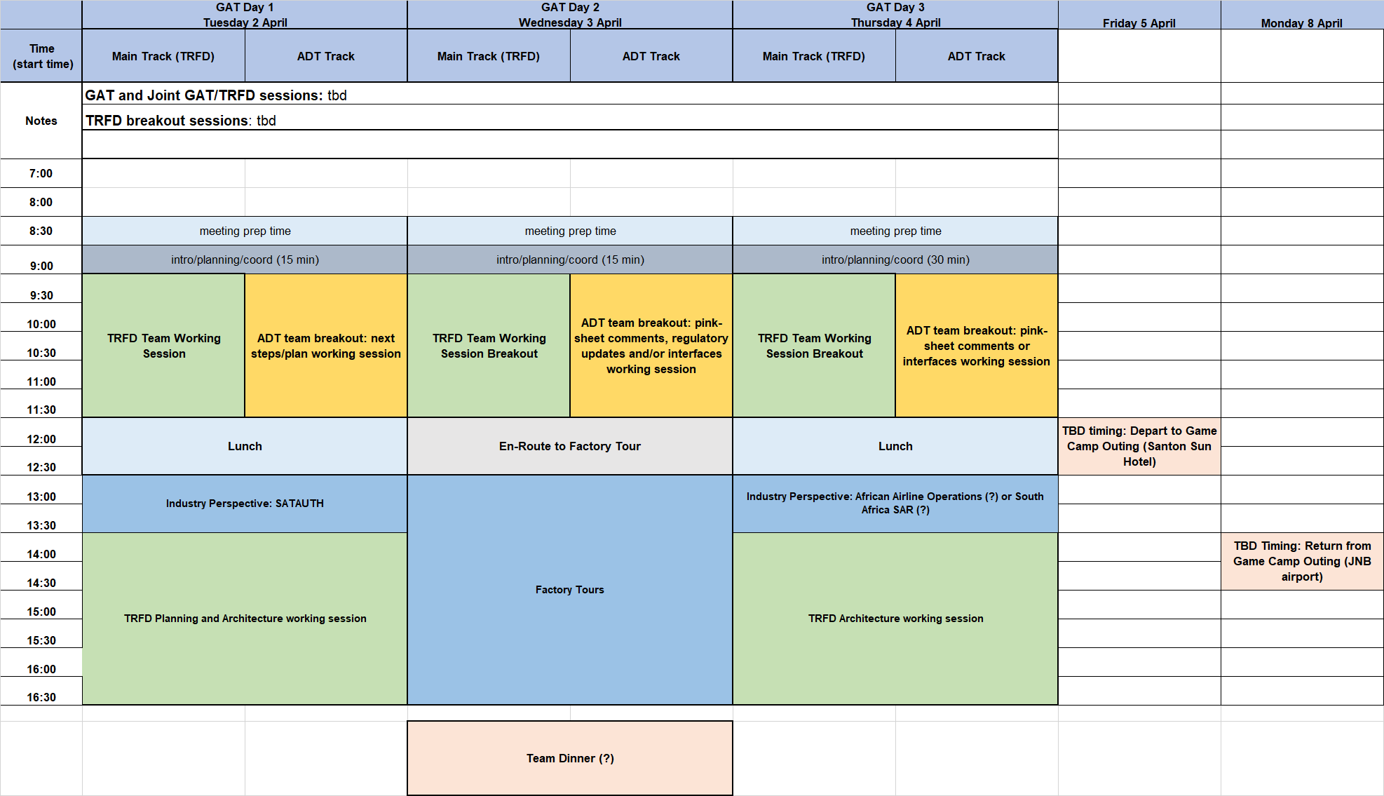
South Africa Agenda (Rough draft 00)
Web-ex sessions for main/TLDR and ADT planned

Slide 6
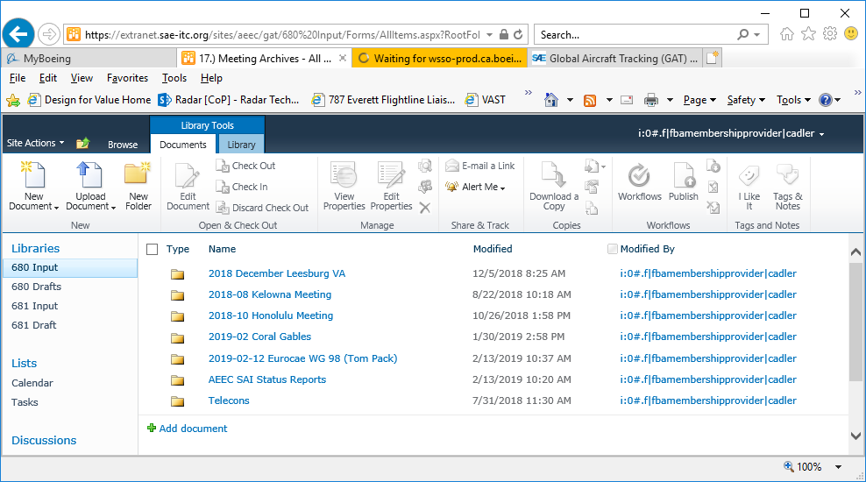
General Material from Coral Gables
AEEC -> GAT -> 680 Input -> 17.) Meeting Archives

Slide 7
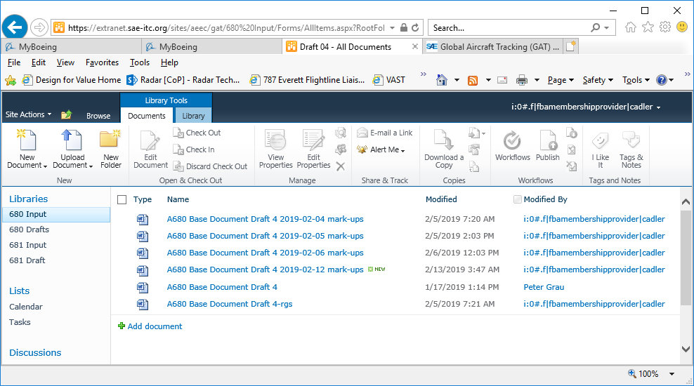
Report A680 revisions
B. Cumulative mark-ups from face-to-face discussions
C = A + B Current version
A. Greg’s mark-ups
AEEC -> GAT680 Input -> 04.) ADT Requirements and Architectures Report -> Draft 04

Slide 8
Report updates needed
02.) References (ICAO GADSS CONOPS etc.)
1.) 10054 section sync
2.) Appendix B clean up
3.) intro clean up and scrub
4.) battery section
5.) add updates from notes to aircraft integration section
6.) remove red text from interfaces sections
7.) add context to architecture sections (Iridium tracker discussion?)
8.) other industry perspectives? – summary of RCC/MCC perspectives?
9.) general scrub and clean-up
10.) antenna interface section – TBD.
11.) DTR section update
12.) review of meeting notes for inputs identified over the last month

Slide 9
Around the Room?
02.) References (ICAO GADSS CONOPS etc.)

