Slide 1
ARINC Airline Electronic Engineering Committee (AEEC) Systems Architecture and Interfaces (SAI) Subcommittee Global Aircraft Tracking (GAT) Team Telecon February 20, 2019 REV A (with Notes)
Chuck Adler
Project Engineer
Boeing Commercial Airplanes, Avionics
(charles.o.adler@boeing.com)
Cell: +1 206-578-2533
Peter H. Grau
Principal Engineer,
ARINC Industry Activities
<Peter.Grau@sae-itc.org>
https://www.aviation-ia.com/activities/global-aircraft-tracking-gat-working-group

Slide 2
Agenda
02.) References (ICAO GADSS CONOPS etc.)
1.) Schedule Review (5 min)
2.) Antenna and other open interfaces discussion (45 min)
3.) RCC take-aways discussion (20 min)
4.) Draft A680 Report mark-ups, A681 Straw Horse Update (15 min)
5.) Round-the-Room (5 min)

Slide 3
Upcoming Meeting Schedules 2019 Look-Ahead
1/9 – 4/24 Weekly telecons (subject to adjustment)
1 every 3 week ADT telecons coordinated with 1 every 3 week TRFD telecons
Web-ex invite sent
Boeing
Seattle
1st ½ of Aug
(are there conflicting dates in Aug?)
Inmarsat
Hawaii
(Honolulu area)
Oct 24-26
Iridium
WA DC Area (Leesburg, VA),
Gables Engineering
Coral Gables Florida
SatAuth
Johannesburg SA
AEEC General Session
Airbus Toulouse
Dec 4, 5, 6 (+7)
Feb 4-6 (SAI 7-8)
April 29-May 2
June 17-19 (SAI 20-21)
April 2-4
2/12-15 Eurocae WG 98 RLS (Tom)
Aug (tbd)
IQPC Conf
2019
2018
4/9-4/11 ICAO DTR operator workshop
11/14 EASA LAD Operators
6/3 - ? ICAO DTR functional workshop
9/10 EASA LAD Enablers
4/2-4/4 IATA Safety and Flight Ops Conf (Blake)
SEPT
OCT
NOV
DEC
JAN
FEB
MAR
APRIL
MAY
JUNE
JULY
AUG
TRFD (ARINC 681) Strawhorse #1
February (following FL meeting)
TRFD ARINC 681 report now an integrated requirements, architecture and proposed standards report
AEEC Mid-Term SESSION (10/14)
2019 Plan notes:
1.) We will continue weekly team telecons (ADT focused) through April time frame to cover report 680 completion
2.) After April time frame we will shift to a more moderate schedule following that of the TRFD group – 1 meeting every 3 weeks or, coordinated with the TRFD meeting so as not to interfere with each other.
3.) April General Session (Prague): A680 document for approval at the General Session, GADSS symposium
4.) We anticipate one more 2019 meeting, probably US east coast, in the Oct/Nov time frame. We may try to coordinate a cross domain (e.g. AEEC, MCC, RCC) type discussion as part of this session.
5.) ICAO DTR Operators workshop (Montreal) schedule update 4/9-4/11- see above and sharepoint (AEEC -> GAT -> 680 Input -> 17.) Meeting Archives)
6.) ICAO DTR Functional workshop (Montreal) schedule targeted for 6/3 see above and sharepoint (AEEC -> GAT -> 680 Input -> 17.) Meeting Archives)
7.) Dukane Seacom has volunteered to host our December meeting in Sarasota Florida.
April 2019 South Africa Meeting Announcement:
https://www.aviation-ia.com/sites/default/files/media-files/GatAnnounceApr19.pdf

Slide 4
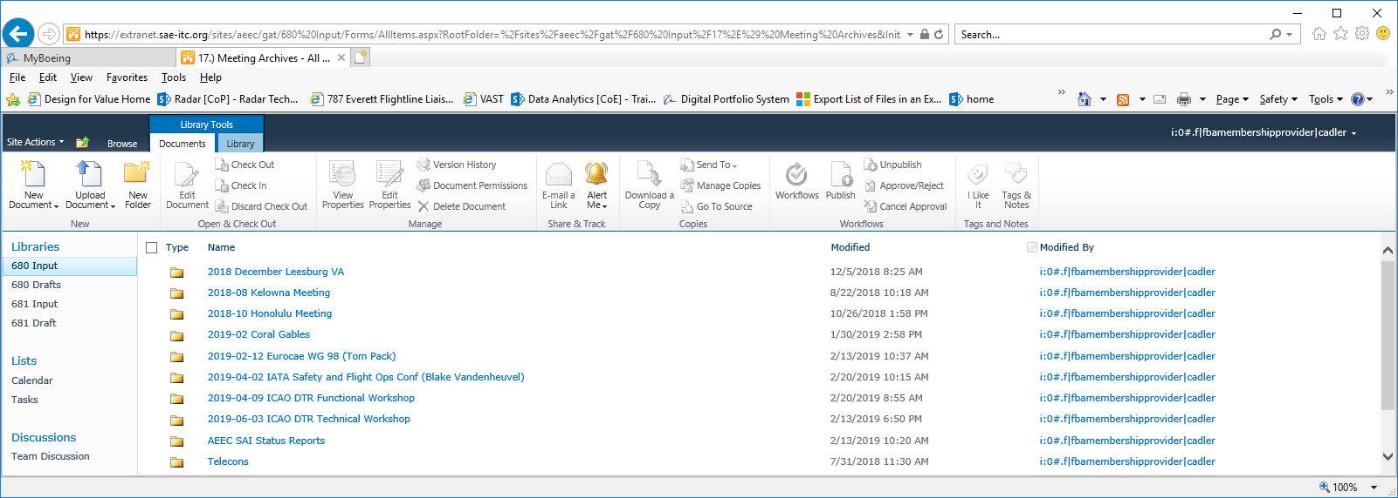
Folders for Upcoming Outside Meetings
AEEC -> GAT680 Input -> 17.) Meeting Archives
ICAO DTR workshops: Copies of e-mail announcements with contact info
IATA: Draft presentation and recent relevant presentations

Slide 5
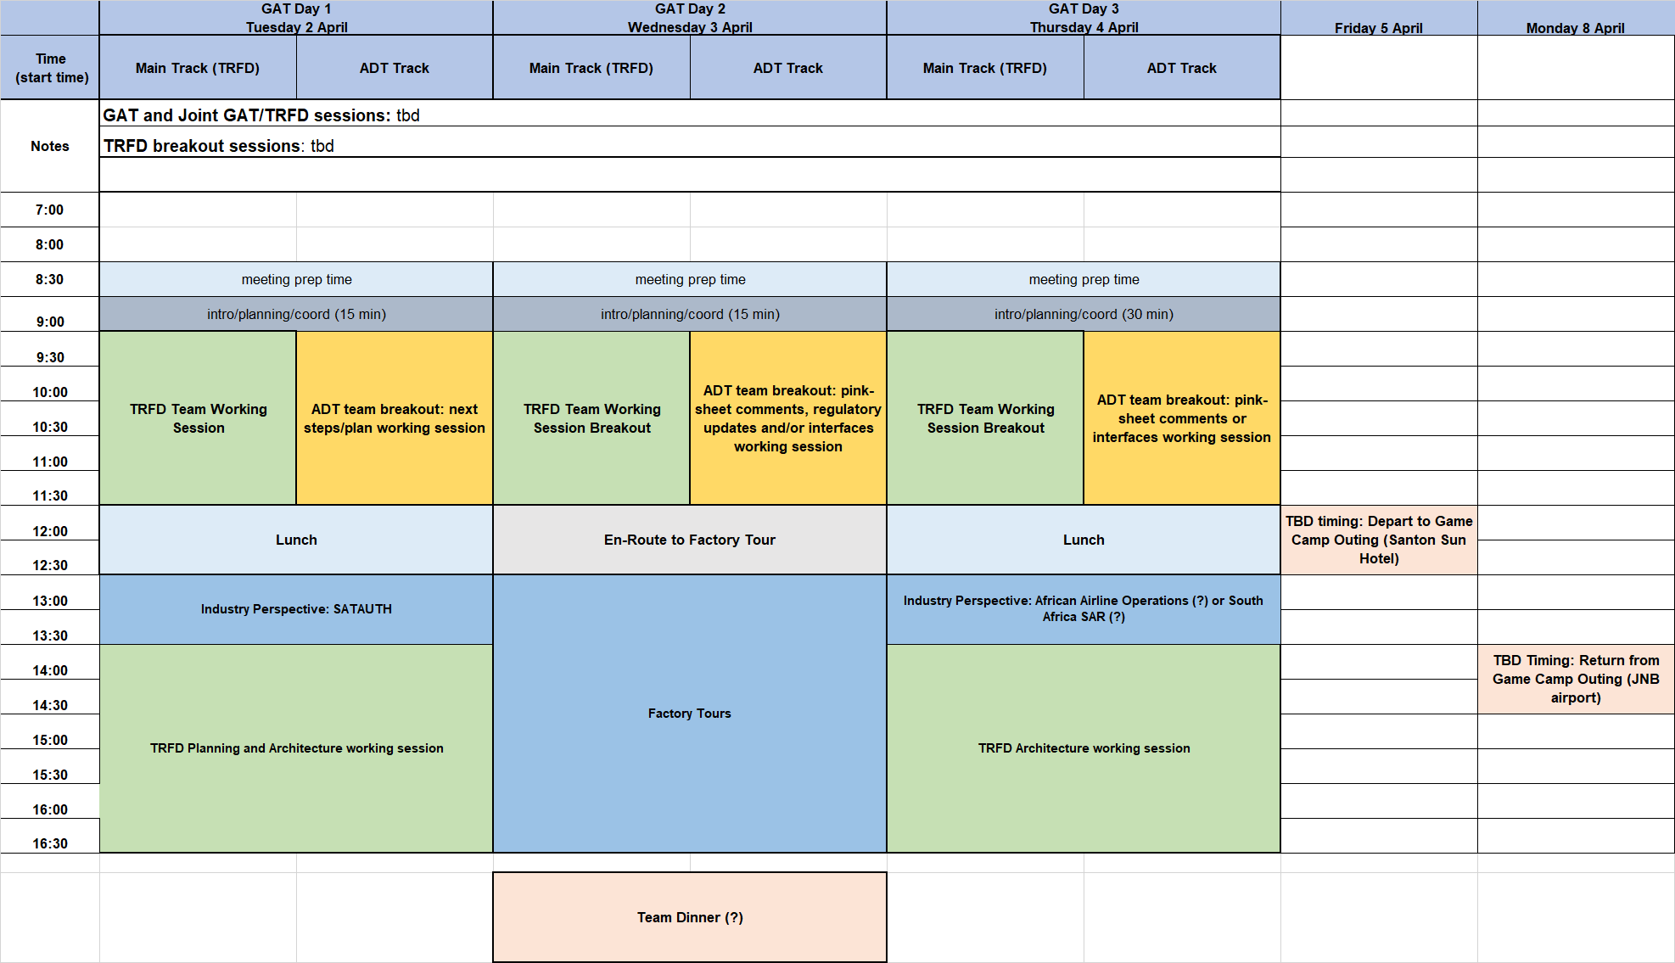
South Africa Agenda (Rough draft 00)
Web-ex sessions for main/TLDR and ADT planned

Slide 6
Interfaces Discussions
02.) References (ICAO GADSS CONOPS etc.)
1.) Antenna Footprint proposal – review and discuss what level of consensus we have – see slide 7 for current proposal and work to finalize on 2/27
2.) Other interfaces – review A429 interfaces for applicability for use from flight deck switches etc… - way forward – no changes to current A429 defintions, add discussion to interface section on how the current words could be used in this role (SDI and trigger origin matrix = manual) – general topic is proposed to brought forward for post-report ADT interfaces work (defined SDI?, add separate label?, what is conops for multiple ADT-Module architectures etc…)(addiuitonal note: A429 Part 2 final draft is already out in circulation)
3.) ELT(DT) connectors – not addressed, will need to be brought forward for post-report ADT interfaces work – possibly some general guidance can be added here based on previous discussions – discuss in 2-27 telecon.

Slide 7
2019-02-20 ELT(DT) Antenna Interfaces Proposal
Aircraft forward direction
152.4 mm
6.0 in
Verify that these are airplane hole dimensions
6 holes
Diameter 5.6 mm (0.22 inches)
9.9x100 deg (?)
what is this specifying? How does this translate into English system?
41.28 mm
1.625197 in
(or 1.625 with .01” tolerance)
76.2 mm
3.0 in
38.1 mm
1.5 in
28.58 mm
1.125197 in
Or 1.25 with .01” tolerance
Proposed Tolerance
+/- 0.25 mm,
(0.010 in)
preferred
100mm (3.94 inches)
optional
Interface described in terms of aircraft fuselage penetrations only:
Attachment penetrations:
6 hole Airbus proposed attachment pattern/hole radius proposal (as above)
Discussion, this is a fairly/very common attachment footprint for existing ELT antennas and should support simplified production and minimum change retrofit installations.
RF Connector penetration(s):
Preferred/primary penetration:
Airbus proposed forward antenna output hole location
Single RF connection supports ELT (121.5, 243 (optional), 406), and GNSS signals
Aircraft penetration radius must support BNC/TNC and smaller connectors
Optional 2nd penetration:
2nd penetration is Boeing proposed aft antenna hole location (100 mm aft of forward hole, center to center)
Dual RF connections supports separate ELT (121.5, 243 (optional), 406) and GNSS signal paths
Aircraft penetration radius must support BNC/TNC and smaller connectors
Finalize at 2/27 telecon

Slide 8
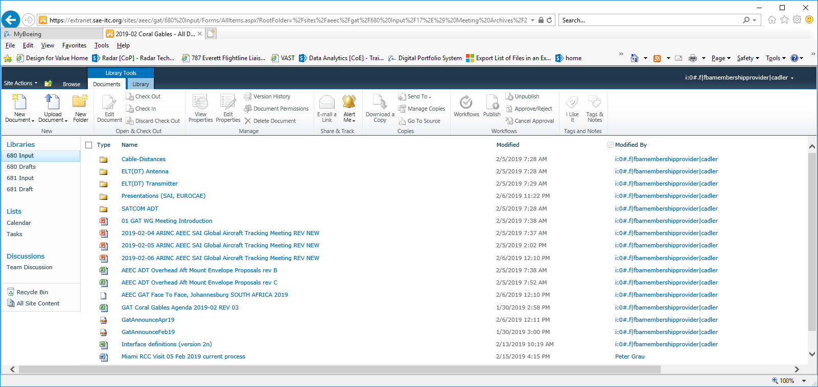
Miami USCG District 7 Rescue Coordination Center Visit Discussion
Paul Roux’s summary: AEEC -> GAT680 Input -> 17.) Meeting Archives -> 2019-02 Coral Gables -> Miami RCC Visit 05 Feb 2019 current process
Chuck’s major notes/take-aways:
General
USCG RCC is extremely competent and rescue mission focused
Busiest RCC in US (probably the world)
Very strong bias for action: alerts are assumed valid and response effort starts immediately – in parallel validation takes place
Very lean staff, several on duty staff, more on call, work-stations allow queuing and managing a high number of incidents
Rigorous procedures for incident tracking and closure
Responses range from police checking out EPIRB activated in marina to multi aircraft/helicopter mid-Atlantic rescues.
Aircraft event related
An air transport alert is treated as a potential mass casualty event and is a top priority for handling
RCC community is very aware of ICAO GADSS is discussing in major forums
Relatively few aircraft knowledgeable staff (2 out of several hundred people at RCC)
Typically the rescue coordinators would have little interaction with FAA controllers, they do have access to FAA surveillance tracks and to radar return chat rooms for timely assessment of radar data.
There have been examples of ELTs inadvertently activated in flight – for example a flight from South America to US, ELT was active entire way due to fault.
Very interested in on going dialog with industry as we go forward (would be good candidate for revisit in 2020 Feb if at Coral Gables)
Other?
Proposed include as section in Industry Perspectives, add MCC take-aways and notes as well.

Slide 9
Report A680 Release Schedule
Gables Engineering
Florida F2F
AEEC General Session
Iridium WA DC
F2F
SatAuth
Johannesburg SA
April 29-May 2
Dec 4, 5, 6 (+7)
Feb 4-6 (SAI 7-8)
April 2-4
2018
2019
DEC
1H
Dec
2H
JAN
1H
JAN
2H
FEB
1H
FEB
2H
MAR
1H
MAR
2H
APRIL
1H
APRIL
2H
May 1H
Draft 3
AEEC DL release 1/17
Draft 3+
A680 Base Document Draft 4 2019-02-12 mark-ups.docx
(structure updated)
Final Draft
ARINC 680
Submitted to ARINC
Feb 28 2019
Final Draft
ARINC 680
Circulated
Target 3/15
Final telecon – goal is to have all inputs incorporated for review at this meeting.

Slide 10
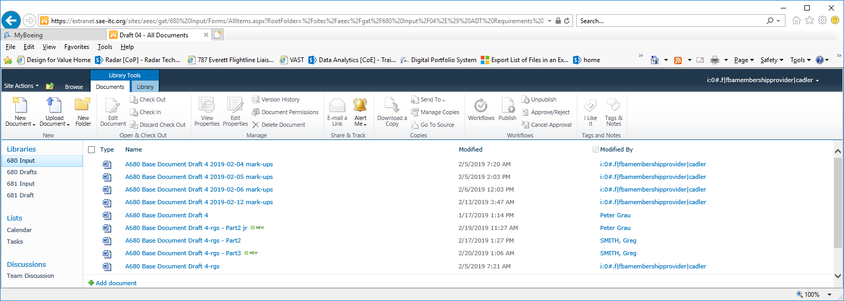
Report A680 revisions
Current version
To be added
AEEC -> GAT680 Input -> 04.) ADT Requirements and Architectures Report -> Draft 04

Slide 11
Report updates needed
1.) 10054 section sync
2.) Appendix B clean up
3.) intro clean up and scrub
4.) battery section
5.) add updates from notes to aircraft integration section
6.) remove red text from interfaces sections
7.) add context to architecture sections (Iridium tracker discussion?)
8.) other industry perspectives? – summary of RCC/MCC perspectives?
9.) general scrub and clean-up
10.) antenna interface section – add proposed footprint into ELT(DT) architecture section, review on 2/27.
11.) DTR section update
12.) review of meeting notes for inputs identified over the last month
13.) add volume and linear recommendations to ELT(DT) architecture sections
14.) incorporate Greg and Janine mark-ups
15.) clarification or example of use of A429 202 as flight deck activation label (discuss use of SDI and trigger origin matrix setting) and label 201 as feedback to potential flight deck interfaces.

Slide 12
Around the Room?
02.) References (ICAO GADSS CONOPS etc.)

