Slide 1
ARINC Airline Electronic Engineering Committee (AEEC)
Systems Architecture and Interfaces (SAI) Subcommittee
Global Aircraft Tracking Telecon #1
May 15 2017
Charles Adler, Project Engineer
Boeing Commercial Airplanes, Avionics
(charles.o.adler@boeing.com)
Peter H. Grau
Principle Engineer,
ARINC Industry Activities
Paul J. Prisaznuk
Executive Secretary and Program Director ,
Airlines Electronic Engineering Committee (AEEC)
ARINC Standards Development

Slide 2
Meeting Purpose and Agenda
  Purpose: APIM 17-004 - Autonomous Distress Tracking kick-off
  Introductions (10 min)
  Recap of APIM 17-004 - Autonomous Distress Tracking Kick-off Plan (10 min)
  Upcoming Schedule Review/Discussion (5 min)
  Review of 2/17 Miami Review APIM Versions (10 min)
  Discussion of updates/developments in driving requirements (5 min)
  Upcoming meeting and working session coordination/logistics discussions (10 min)
  Discussions/Conclusion (10 min)

Slide 3
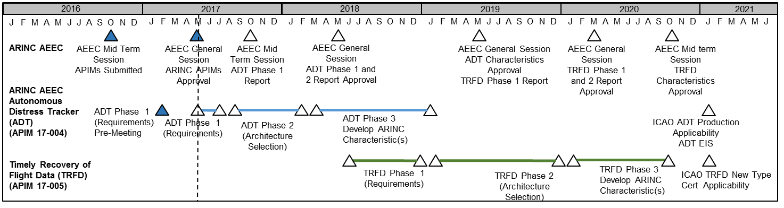
ADT Requirements Phase Schedule
May 15 - June: working telecon sessions start
6/13-14 SAI meeting (Denver)
6/15-16 (Thursday-Friday)(Denver)
  GATteam Phase 1 ADT requirements face-to-face
August 16-18 (Wednesday to mid-Friday)(Seattle)
  GAT team Phase 2 architecture options kick-off face-to-face, Phase 1 finalization

Slide 4
ADT Requirements Development Tasks and Goals Discussion
Plan for Requirements Phase (Today’s focus)
  Requirements sufficiently mature/complete to allow architecture phase initiation (August 2017)
  Complete phase 1 requirements report out (October 2017)
  Report submission and review in General Session with Phase 2 report (May 2017)
  APIM summary:

Slide 5
ADT Requirements Development Tasks and Goals Discussion
Plan for Requirements Phase (Today’s focus)
  Requirements Development Tasks
  Requirements Completeness:
    Determine gaps/areas where requirements development is still ongoing/maturing
    Ensure applicable requirements identified and included (e.g. IATA etc…?)
    Identify industry relevant requirements not covered in requirements sources (e.g. “ilities”, operational goals etc…)
  Requirements Maturity
    Identify requirements that need further development/refinement
    Identify expected assumptions for immature requirements
    Develop derived or identified requirements set to use in architectural Selection Phase
  Requirements Prioritization/Relationships
    Identify/resolve potential conflicting requirements
    Identify priority or criticality of requirements to use in architectural Selection Phase
  Other?
  Complete phase 1 requirements report out (October 2017)
  Report submission and review in General Session with Phase 2 report (May 2017)

Slide 6
Sources of ADT Requirements
International Civil Aviation Organization
(ICAO)
European Organisation for Civil Aviation Equipment (EUROCAE)
European Aviation Safety Agency
(EASA)
European Union
(EU)
5.11 not formally released – need to verify with ICAO version to use
GADSS CONOPS Draft 5.11
(1 December 2016)
Normal and Distress Tracking, TRFD, ELT
ED-237
(February 2016)
Minimum Aviation System Performance Specification (MASPS) for Criteria to Detect In-Flight Aircraft Distress Events to Trigger Transmission of Flight Information.
COMMISSION REGULATION (EU) 965/2012
5 October 2012
Technical requirements and administrative procedures related to air operations
Annex 6 to the Convention on International Civil Aviation, Part 1, Tenth Edition
(July 2016)
Standards and Recommended Practices (SARPs): Distress Tracking, TRFD, ELT changes
COMMISSION REGULATION (EU) 2015/2338
11 December 2015 Amends 965/2012 to add CAT.GEN.MPA.210 Location of an Aircraft in Distress
Annex 11, 14th Edition
(2016)
SARPS for Distress Reporting
Executive Director (ED) Decision
2016-012
Acceptable Means of Compliance (AMC) and
Guidance Material (GM) to implementing rules on flight recorders, underwater locating devices and aircraft tracking systems (second set))
(12 September 2016)
AMC and GM related to aircraft tracking systems and to location of an aircraft in distress (refer to Part CAT, CAT.GEN.MPA.205 and CAT.GEN.MPA.210) will be adopted by a Decision published at a later stage
Doc 10054 Manual on Location of Aircraft in Distress and Flight Recorder Data Recovery
(not yet published)
TBD ADT and TRFD guidance material.
Annex II ED Decision 2015/XXX/R
AMC and GM to Part-CAT — Issue 2, Amendment X’
(Draft, ?)
AMC and GM related to aircraft tracking systems and to location of an aircraft in distress
Target: finalized draft manual completed for review at the FLIRECSWG/10 meeting in October 2017

Slide 7
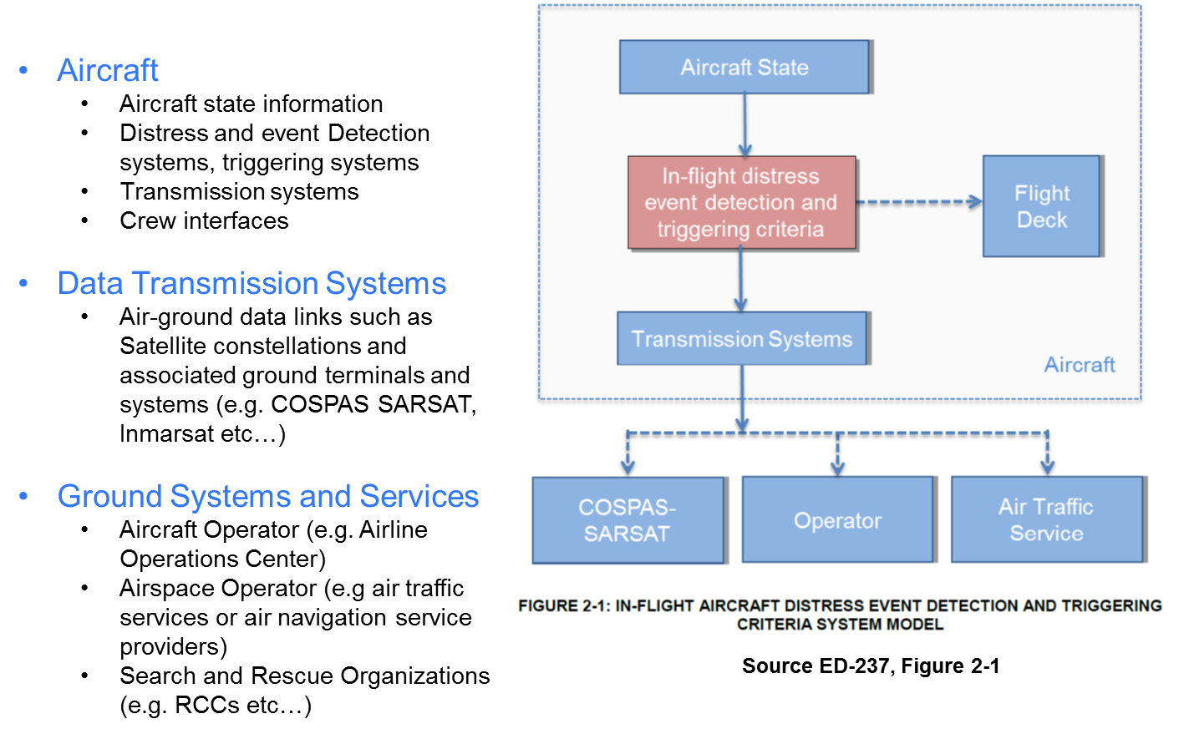
How to Organize Requirements Work?
One Approach – functionally organized working groups:
Aircraft
Data Transmission Systems
Ground Systems and Services
System-of-Systems (end-to-end)
Other Thoughts/Approaches?
Have cross industry (e.g. Airline, OEM, system and service supplier representation) in each group.
Leads – volunteers?

Slide 8
Development Progression Discussion
Completeness
Maturity
Prioritization/
Relationships
Draft Report
Goal for June Face-to-Face – discussions at this level
Goal for August Face-to-Face – this is sufficiently mature to support architecture studies initiation

Slide 9
Discussions

Slide 10
Acronyms
ACARS Aircraft Communications Addressing and Reporting System
ADFR Automatically Deployable Flight Recorder
ADS-C Automatic Dependent Surveillance - Contract
ADS-B Automatic Dependent Surveillance - Broadcast
ADT Autonomous Distress Tracker
AEEC Airline Electronic Engineering Committee
AMC: Acceptable Means of Compliance
AOC Airline Operation Center
APIM ARINC Project Initiation/Modification
ATC Air Traffic Control
ATS Air Traffic. Services
CAT Commercial Air Transport Operations
COMM Communications
CONOPS Concept of Operations
COSPAS/SARSAT Search and Rescue Satellite-Aided Tracking/Cosmicheskaya Sistyema Poiska Avariynich Sudov (Space System for the Search of Vessels in Distress)
CVR Cockpit Voice Recorder
EASA European Aviation Safety Agency
ED EUROCAE Document
ED Executive Director
ELT Emergency Locator Transmitter
ELT-DT Emergency Locator Transmitter – Distress Tracker
EFDR Enhanced Flight Data Recovery
EU European Union
EUROCAE European Organisation for Civil Aviation Equipment
FAA Federal Aviation Administration
FAR Federal Aviation Regulations
FDR Flight Data Recorder
FDS Flight Data Streaming
GADSS Global Aviation Distress Safety System
GATS Global Aircraft Tracking System
GM Guidance Material
GNSS Global Navigation Satellite System
HW Hardware
ICAO International Civil Aviation Organization
kHz kilo-Hertz
LF-ULD Low Frequency Underwater Locator Device
MASPS Minimum Aviation System Performance Specification
NM Nautical Mile
OEM Original Equipment Manufacturer
RCC Rescue Coordination Center
RTCA Radio Technical Commission for Aeronautics inc.
SAI Systems Architecture and Interfaces Subcommittee
SARPs Standards And Recommended Practices
SATCOM Satellite Communications
SC Special Committee
SW Software
TBD To Be Determined
TRFD Timely Recovery of Flight Data
WG Working Group
WRC World Radio Communication Conference

