Slide 1
ARINC Airline Electronic Engineering Committee (AEEC) Systems Architecture and Interfaces (SAI) Subcommittee Traffic Surveillance Working Group ARINC 735C TCAS + ACAS Characteristic Updates March, 2020

Slide 2
DO-260C ADS-B In MOPS Updates
TBD Items
TBD Items
TBD
TBD Items
TBD

Slide 3
DO-385 ACAS-Xa/Xo MOPS Updates
Introduction and Description (section 1) updates to appropriately include ACAS Xa/Xo descriptions
Functional Description (section 3) updates for ACAS Xa/Xo
Update Attachment 19G (Data Link Capability Report) for ACAS Xa/Xo
New Attachment 19M For transmission of Part Numbers (registers E5 and E6)

Slide 4
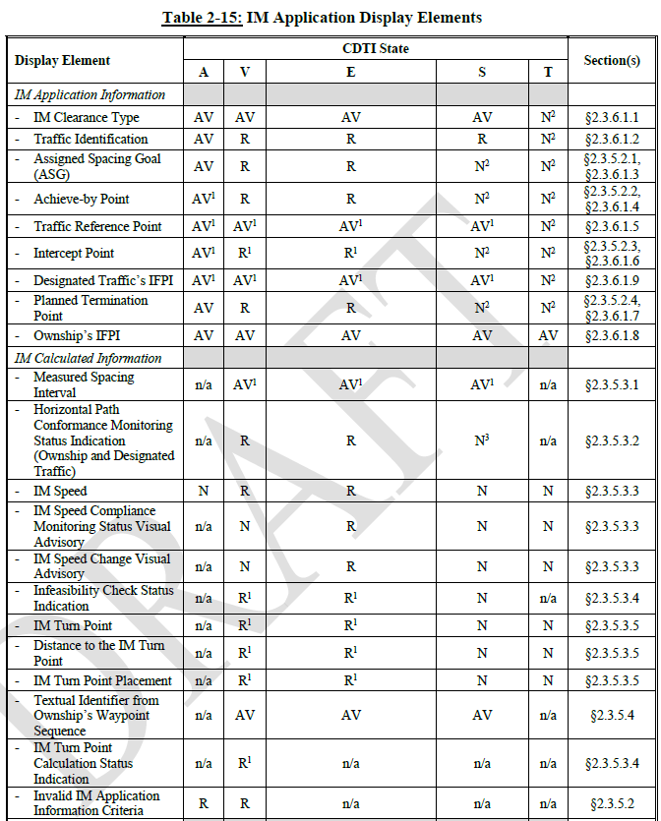
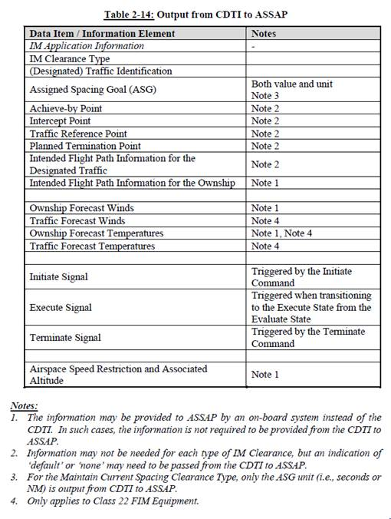
DO-361A FIM MOPS Updates
DO-361 Section 2.3 – Requirements for input and controls (draft version)

Slide 5
DO-XXX ACAS-Xu MOPS Updates
Introduction and Description (section 1) updates to appropriately include ACAS Xu descriptions
Functional Description (section 1) updates for ACAS Xu
Label definition for horizontal resolution advisories and remain well clear (RWC) guidance
Revise Attachment 6F
Revise label definition for TCAS → Transponder (TX bus) transmission of Resolution Advisories Report (register 30)
Revise Attachment 19F
Label definition for TCAS → Transponder (TX bus) transmission of register 31
New Attachment 19K

Slide 6
DO-XXX ACAS-Xu MOPS Updates
Update Attachment 19G (Data Link Capability Report) for ACAS Xu
New Attachment 19N For Operational Status Message data
New Attachment 19O For Operational Coordination Message data
ATAR interface?
TBD

